Slide 1

NET ZERO SCENARIOS: WHAT DO (AND DON’T) THEY TELL US?
François DASSA - EDF

Slide 2
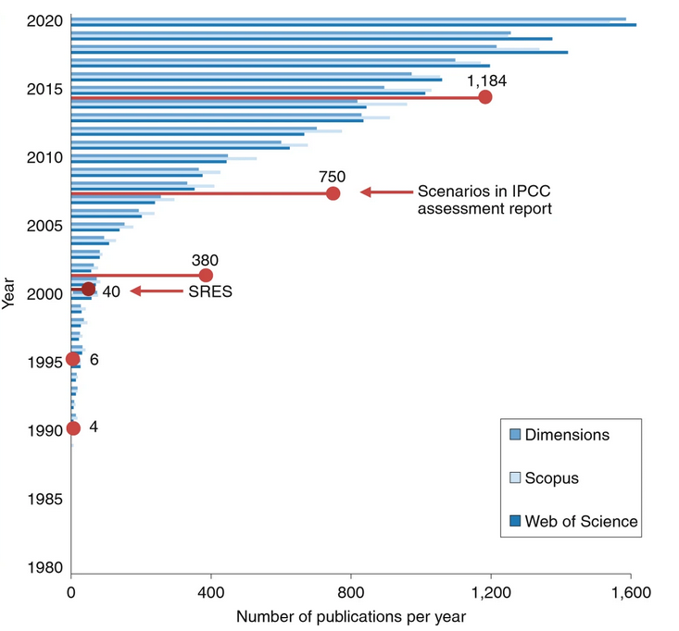
Energy scenarios : a success story…
Source : Guivarch et al - Nat. Clim. Chang. 12, 428–435 (2022)

Slide 3
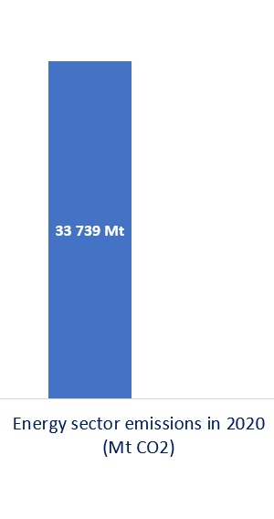

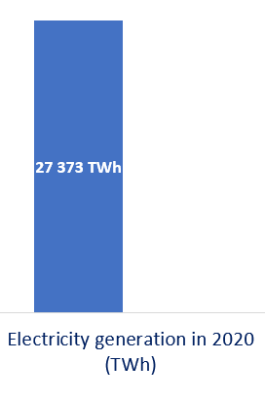

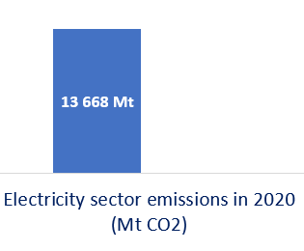
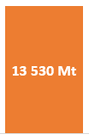

…in strong contrast with energy policy results.
*New Policies Scenario

