Slide 1
Net-Zero: Where are we in the global energy transition?
Sergey Paltsev
Massachusetts Institute of Technology
European Energy Policy Conference
Brussels, Belgium
September 1, 2022

Slide 2
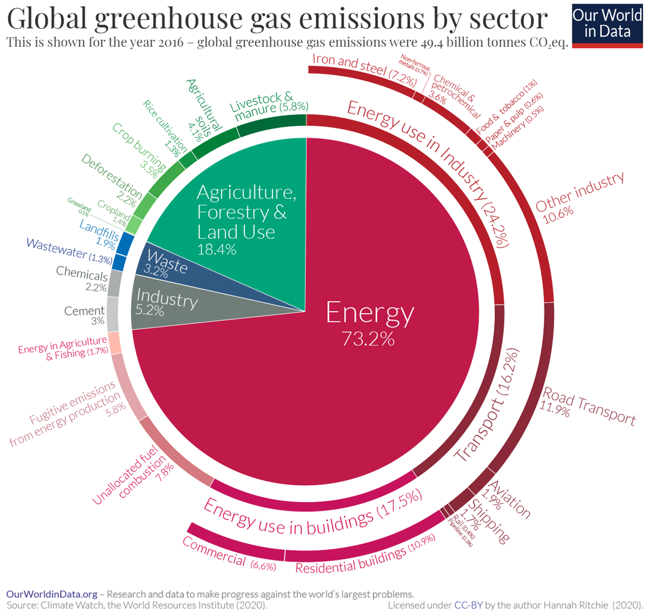

Slide 3
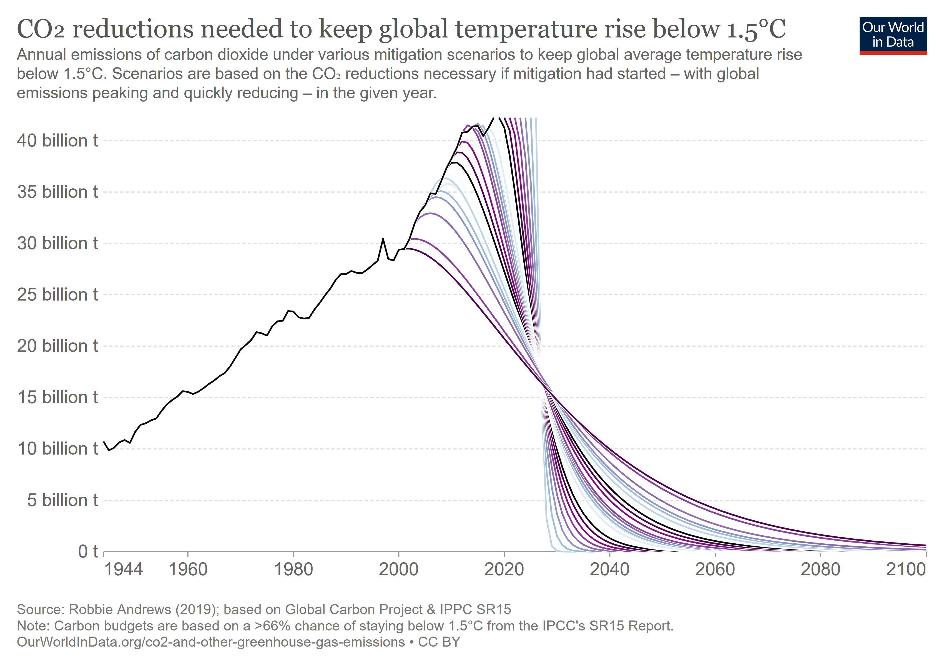

Slide 4
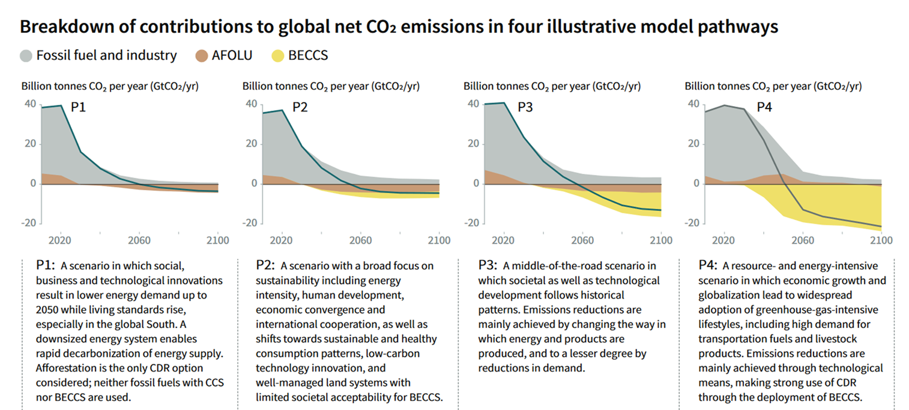
The world has to decarbonize…
Source: IPCC 1.5C Report (2018)

Slide 5
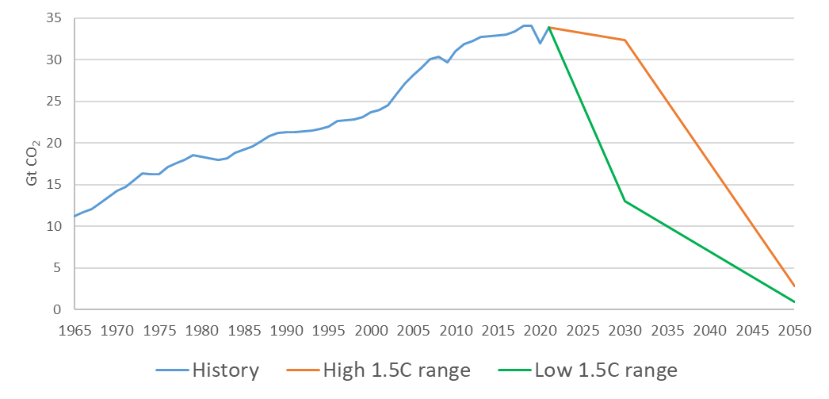
…at an unprecedented pace
Pandemic: 6%
Global financial crisis: 2%
?
Dissolution of USSR is counter-balanced by China’s rise

Slide 6
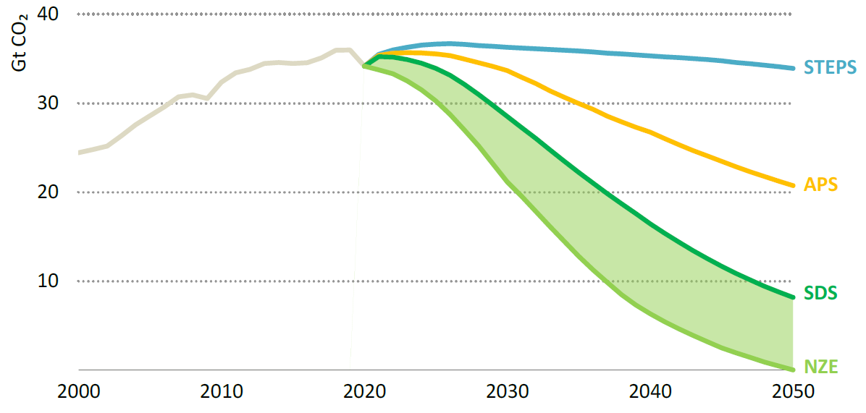
IEA World Energy Outlook 2021: Goals vs Reality
IEA 2021 World Energy Outlook: Goals vs Reality
STEPS (Stated Policies Scenario) reflects current policy settings
APS (Announced Pledges Scenario) assumes that all NDCs and longer term targets are met
SDS (Sustainable Development Scenario) meets UN SDGs
NZE (Net zero Emissions by 2050) for global energy sector

Slide 7
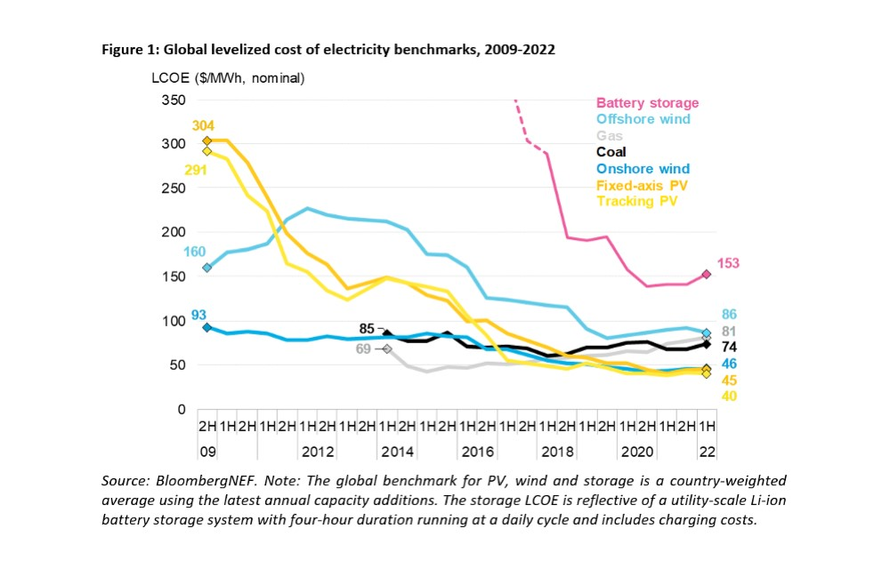
Wind and Solar

Slide 8
Are we done with energy transition?

Slide 10
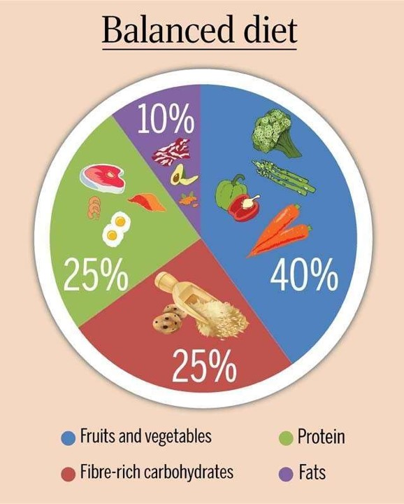

Slide 14
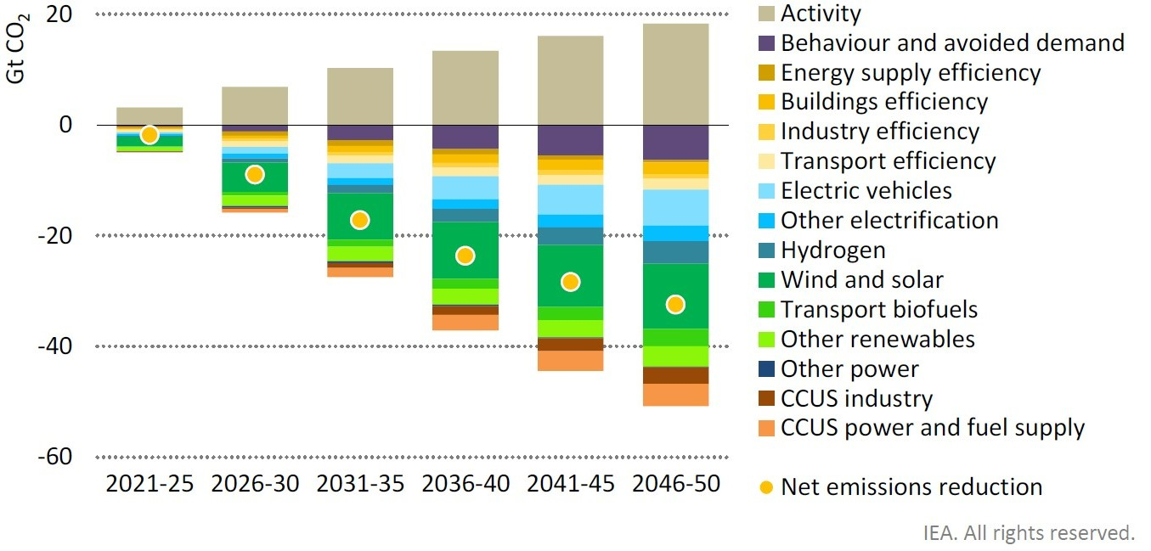
Wide range of measures and technologies are needed
Source: IEA Net Zero by 2050 (2021)

Slide 15
Key assumptions of IEA NZE scenario
15

Slide 16
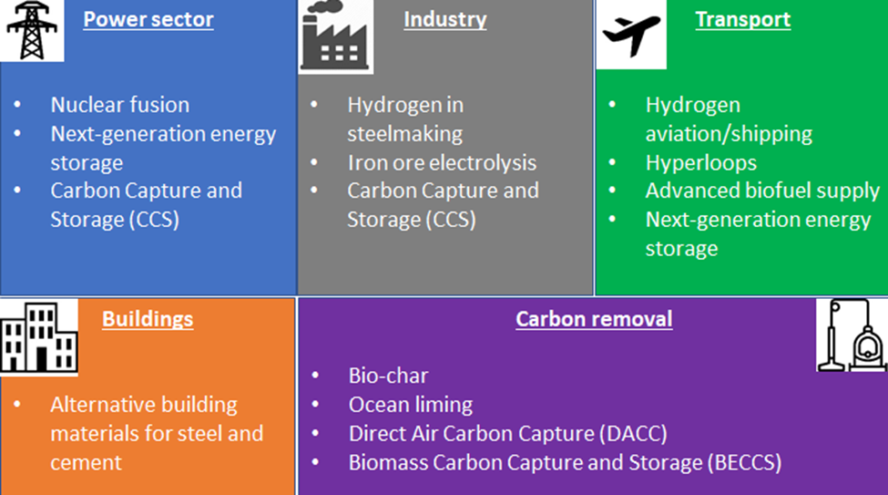
Also important: Demand Side Management
Graphics: EPFL

Slide 17
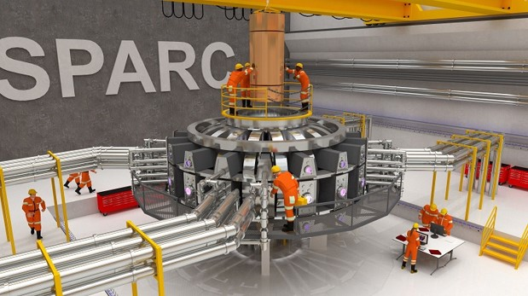
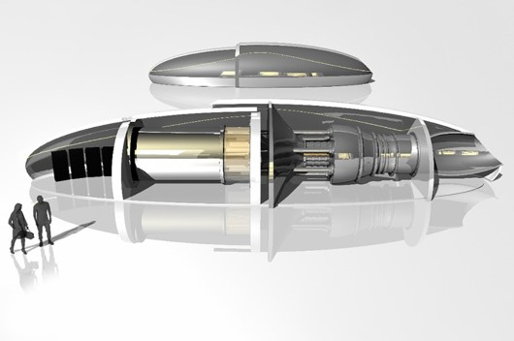
Wide range of future technologies are needed

Slide 18
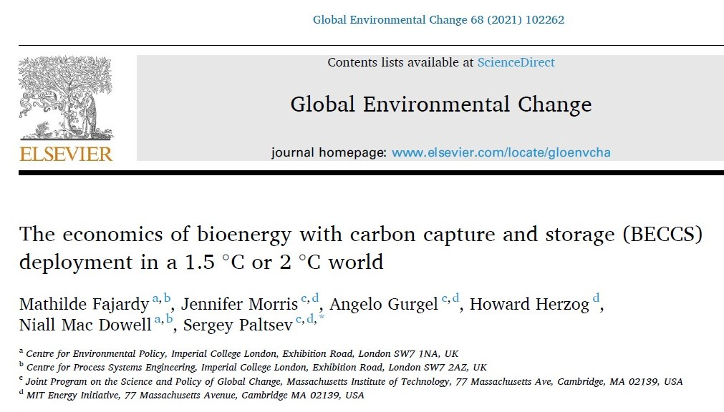
Technological readiness in net-zero scenarios?
https://globalchange.mit.edu/news-media/jp-news-outreach/affordable-direct-air-capture-myth-or-reality

Slide 19
How do we get to net-zero emissions? How quickly?
Pledges by numerous governments and companies to reach net-zero greenhouse gas (GHG) emissions, but Action Plans are needed
Opportunities and challenges for scalable
low-carbon energy options
Economic: Do we have technologies? Are they economically competitive? Do we have policies to support them? Lifestyle changes?
Geopolitical: Impacts of de-carbonization on other goals? COVID implications for a rise of protectionism? Stability of energy exporters? Impacts of Russia-Ukraine war?
Environmental: Physical risks from climate change will be there regardless of emission reduction. Impacts from low-carbon options (e.g., car battery recycling). Minerals for clean energy transition.

Slide 20
Thank you
Questions or comments?
Please contact Sergey Paltsev at paltsev@mit.edu

