Slide 1
Power market design and the EU energy crisis: don’t shoot the messenger
Tim Schittekatte and Carlos Batlle schtim@mit.edu and cbatlle@mit.edu MIT Energy Initiative
CEEPR & EPRG European Energy Policy Conference Brussels, September 1, 2022

Slide 2
Spoiler
Four key questions
What is the issue?
Affordability due to scarcity
What works and what does not work?
Spot market have worked well enough*, long-term markets never did
What are the lessons for the future?
Competitive bidding for long-term contracts for new entrants
Consumer protection needed
What to do and what not do to survive now?
Don’t shoot the messenger
21

Slide 3
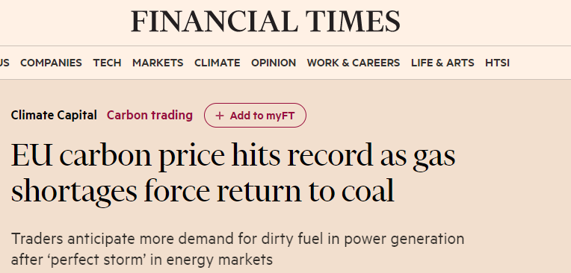
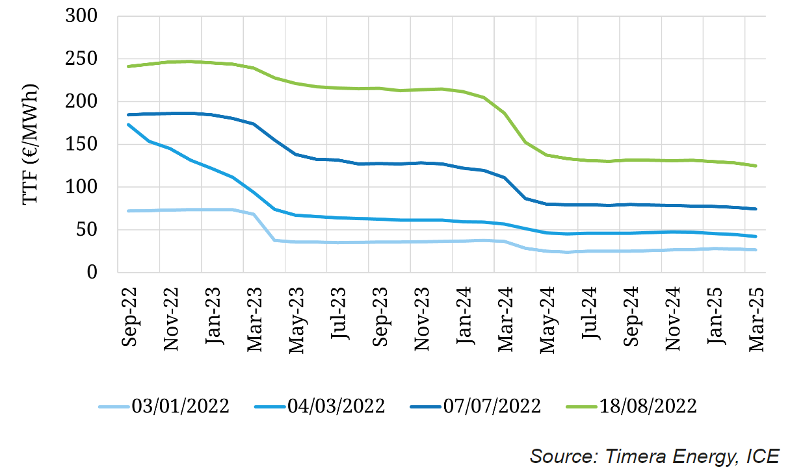
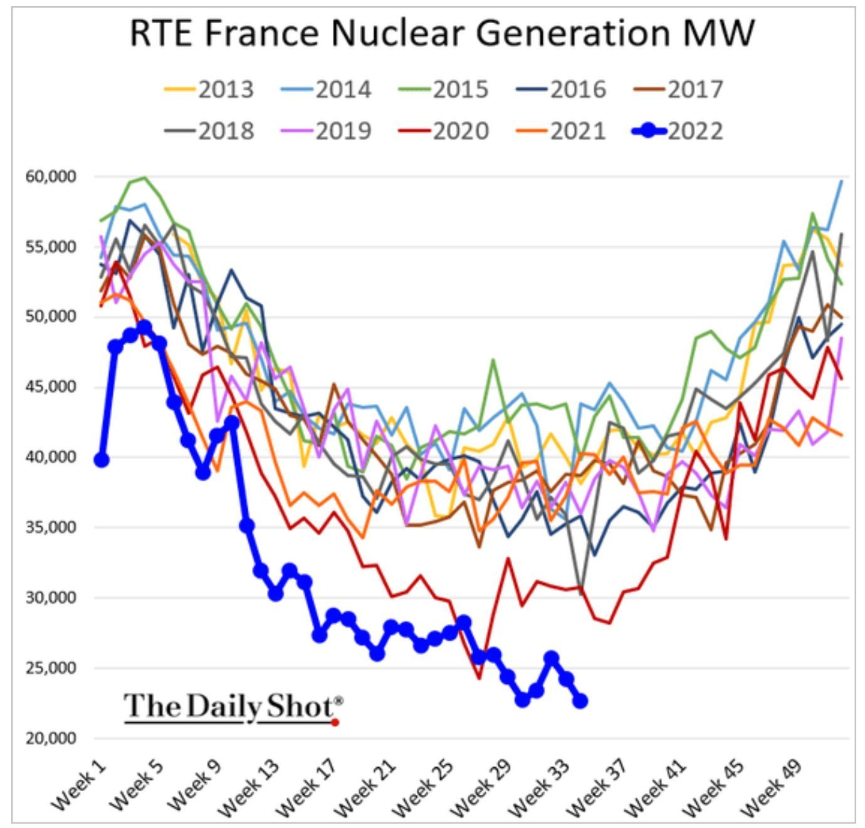
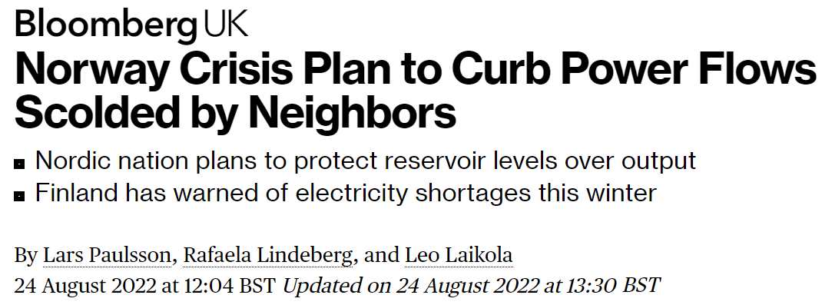
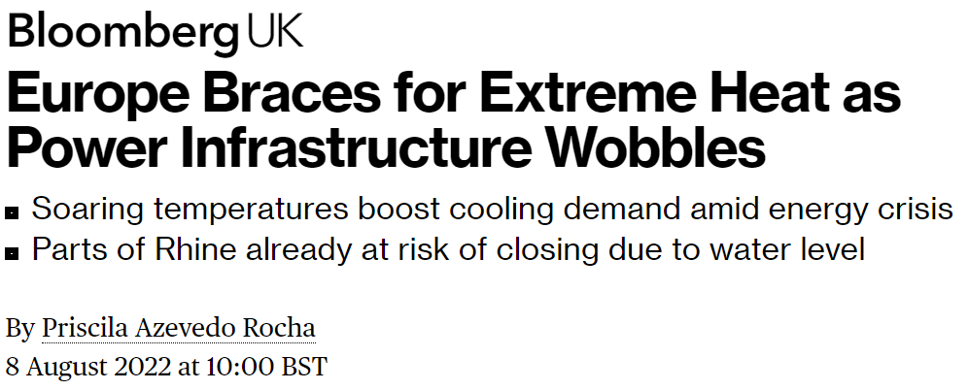
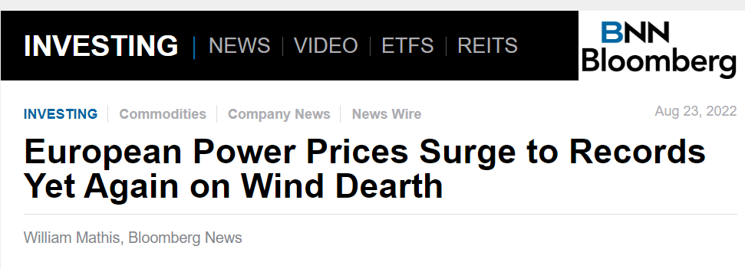
What is going on? The perfect storm
Next 2.5 years : TTF expected to be many times higher than historical average
> 7 times the average TTF price between 2014-2020 (17 €/MWh)
Early days of the invasion of Ukraine
3
Notes:
Today maybe a systematic risk, that justifies intervention but not a counterargument to not improve market design. Several non-systematic risks could have also created big issues.

Slide 4
What is the issue?

Slide 5
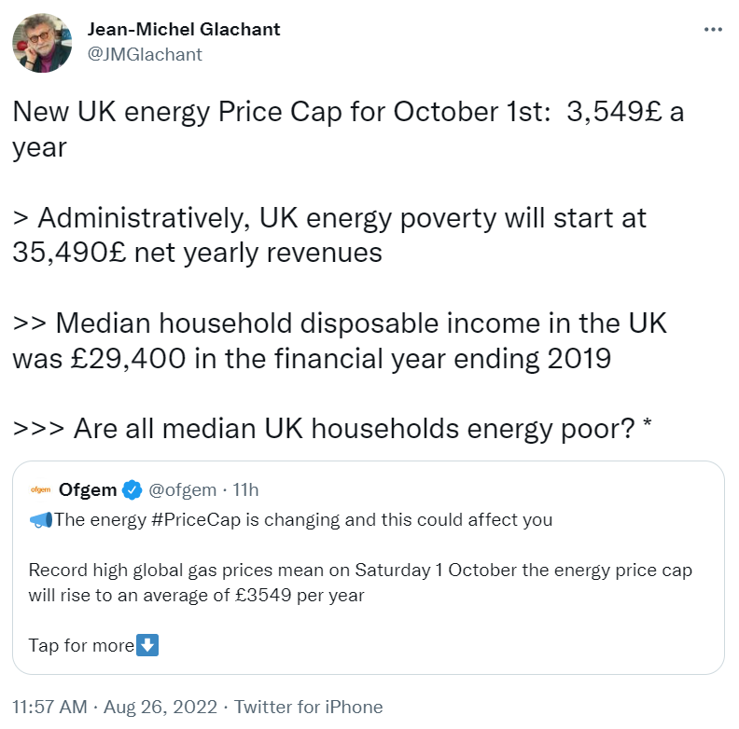
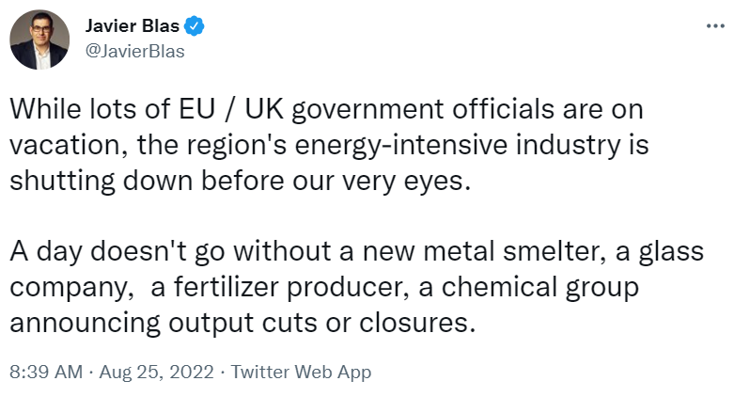
What is the issue? Affordability due to scarcity
5

Slide 6
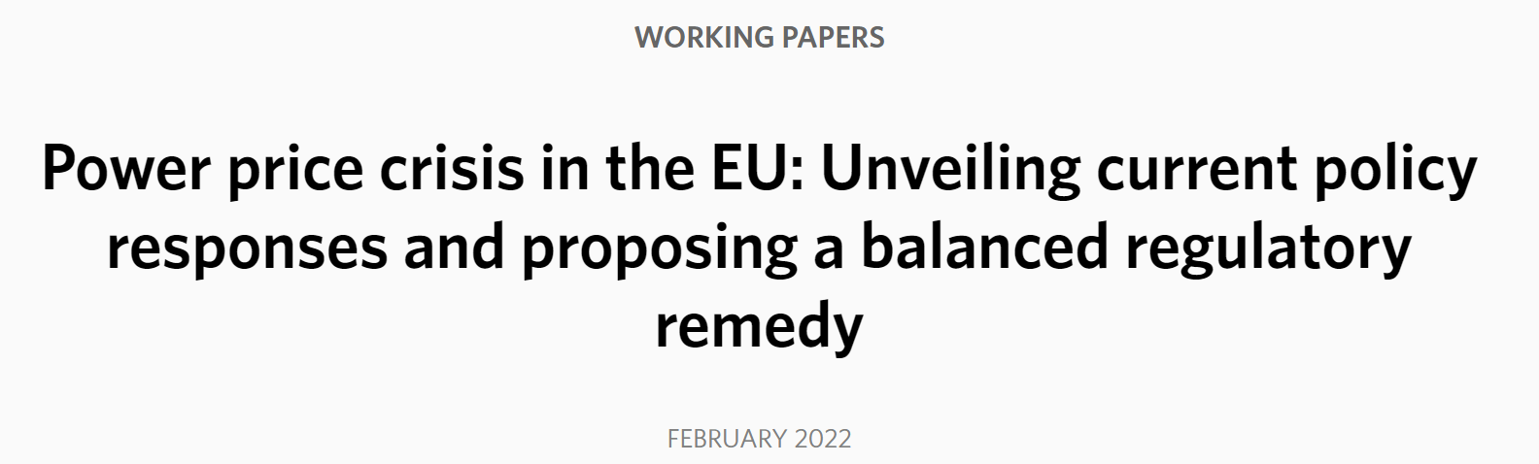
First aid: “rebalancing” income and bills Attempts to capture inframarginal rents and redistribute them
6
Notes:
All are hunting for inframarginal rents

Slide 7
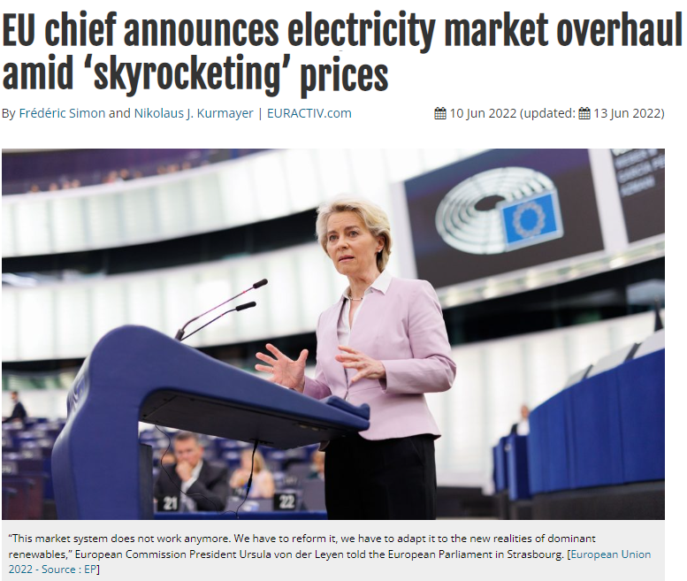
June 10: Brussels completes the U-turn
“This [capturing of windfall profits] is a short-term relief [..] what is the problem is the structure of the market”
“This market system does not work anymore. We have to reform it. We have to adapt it to the new realities of dominant renewables”
7
Notes:
Should we interpret that renewables are to blame? Why does she mention it? INFRAMARGINAL RENT

Slide 8
What works and what does not work?

Slide 9
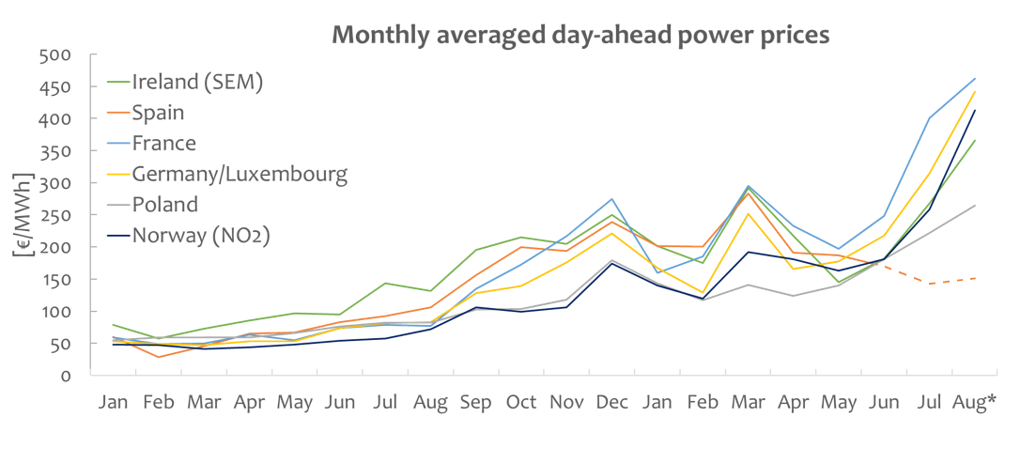
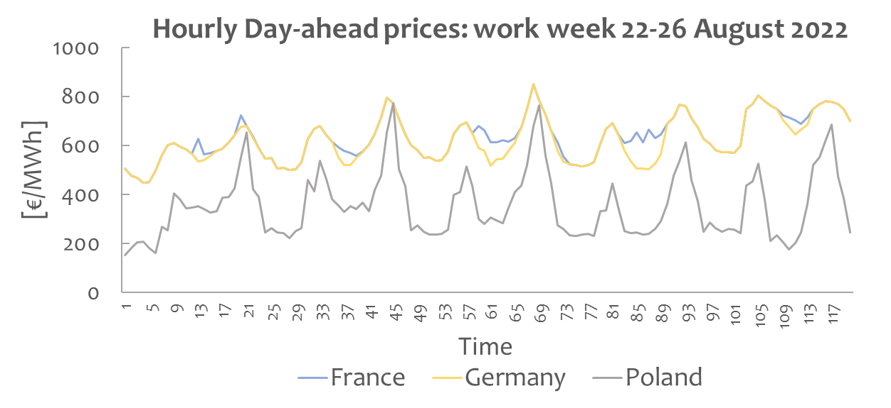
What works? The spot markets
Spot markets reflect the underlying reality
Spot markets are doing their job: least-cost dispatch and provide signals to end users
Market coupling has been a great European success
2021
2022
9
Source: ENTSO-E Transparency Platform *Data until August 26, 2022

Slide 10
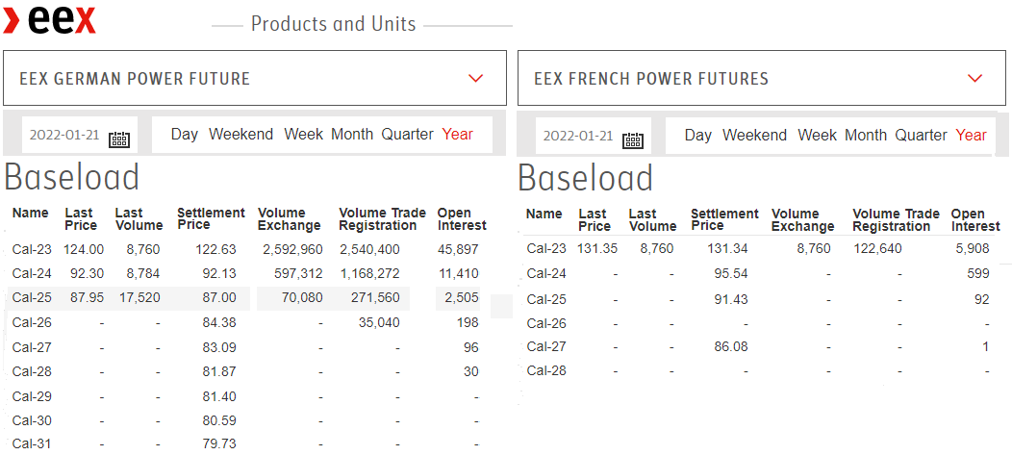
What does not work? Market incompleteness
Past ̴ investment issue in new generation
Today ̴ affordability issue for end users
10
Notes:
Systematic risk? Yes, but not an excuse not to improve the markets further
End game

Slide 11
What are the lessons for the future? [Longer-term “permanent” improvements in power market design]

Slide 12
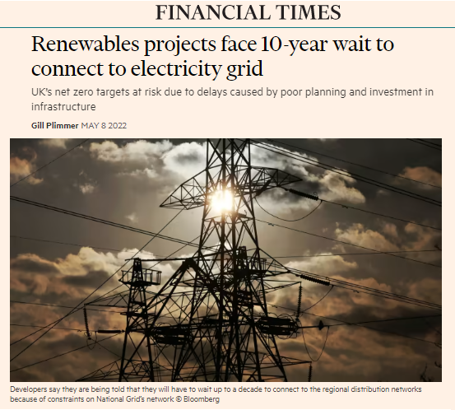
What to do with new access to the network?
 | Choices
Connection | First-come-first serve | Auction for access
Exposure to the price risk | Merchant | Auction for long-term hedge
17

Slide 13
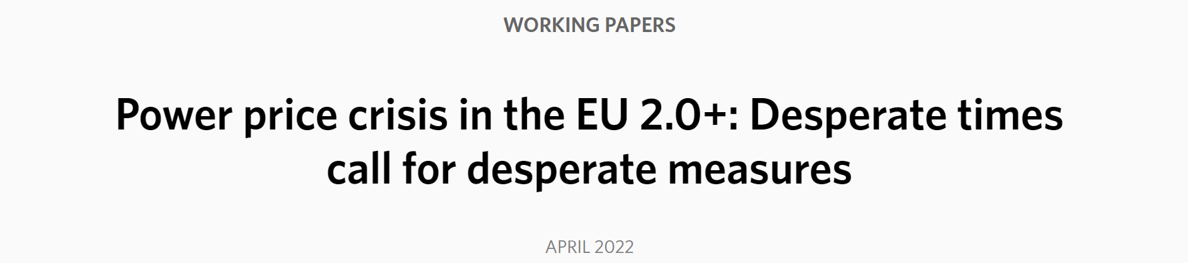
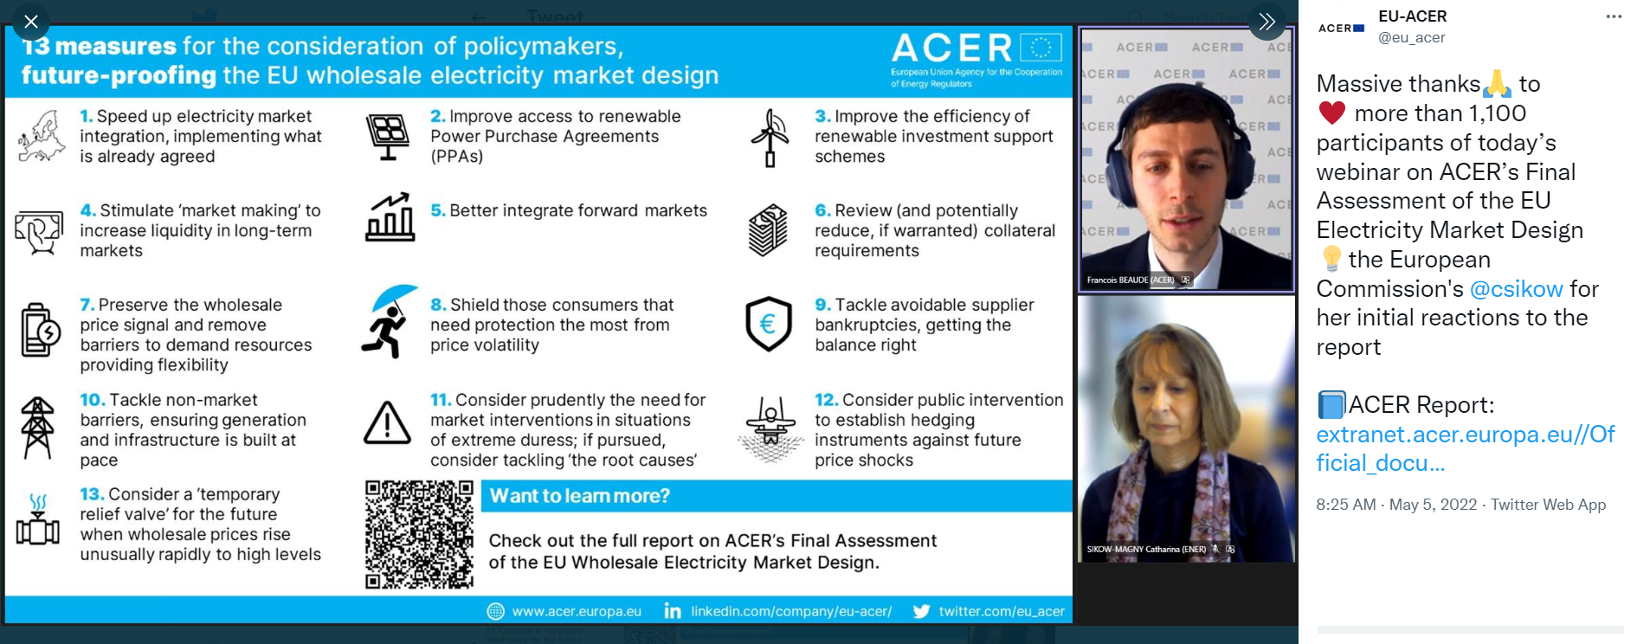
Affordability options Market-based “rebalancing” covering existing and new generation
18

Slide 14
Affordability options
Illustrative example
Different impact of the option depending the nature of the price event
Snow storm
Energy crisis
51 hours with prices above 100€/MWh,
January average price 60€/MWh,
Affordability option not exercised
December average price 239€/MWh
Affordability option in the money
Pay out of 139€/MWh for protected consumers
19

Slide 15
What to do and what not do to survive now? [Short-term “temporary” measures]

Slide 16

What to do now to survive?
Is there another way to solve the affordability issue other than capturing “unexpected” income?
It does not look like
The largest profits are in the gas market
Big issue: a large share of the “unexpected” income is made outside Europe
Only way to capture: intervention in the gas market
Potential interventions in the gas market:
Break open the contracts with Russia
Uniform gas price cap
How to allocate the scarce gas?
Not a new problem
Source: Natureneedsmore.org
12
Notes:
Ex-post without shooting the messenger

Slide 17
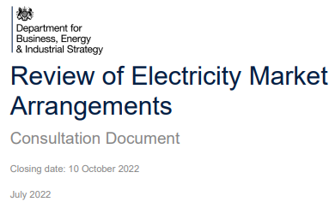
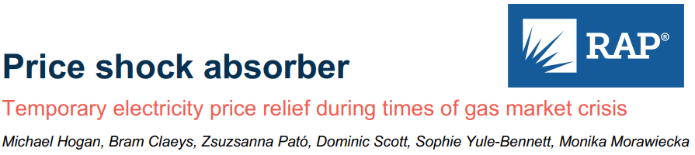
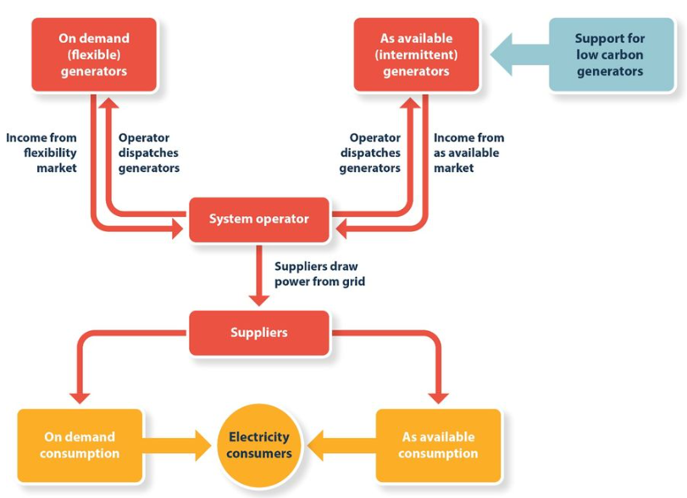
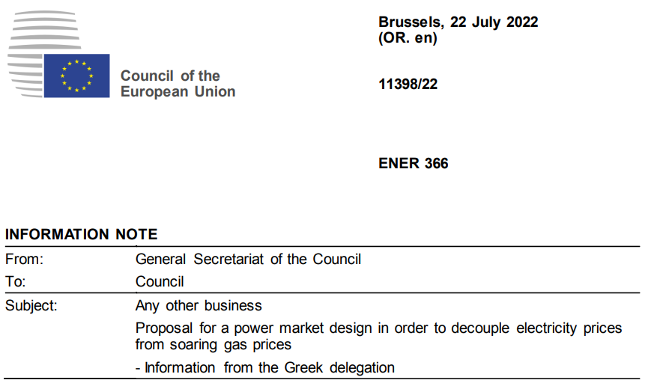
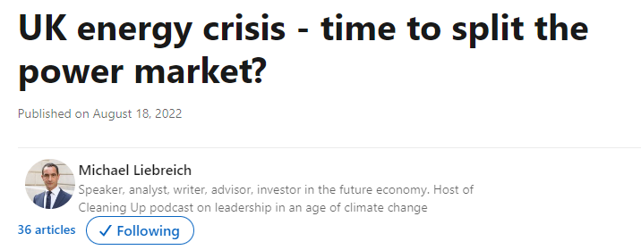
What to do now on the electricity side?
Current proposals: implicit or explicit ways to regulate power prices
1/ “The Iberian exception”
2/ Variants from the “splitting the market” idea
3/ “Price shock absorber”
Source: Keay and Robison (2017)
13
Notes:
Ex-post without shooting the messenger

Slide 18
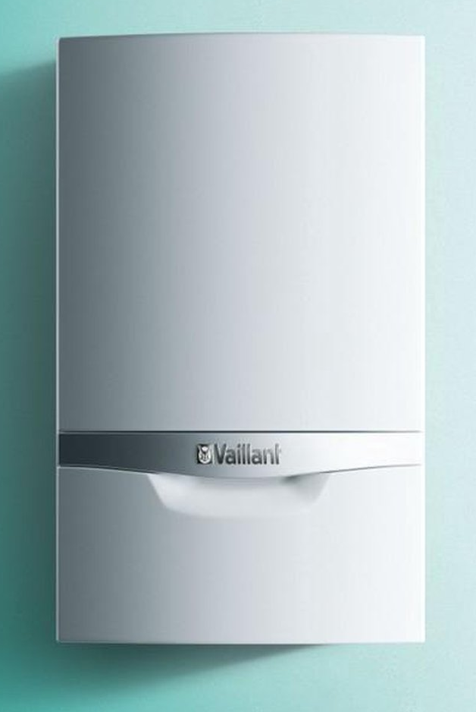

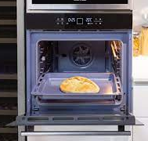
Why not to implicitly or explicitly regulate prices?
Harmful secondary effects, how to deal with:
Optimal dispatch? Cross-border trade?
Unbalanced electricity and gas consumption? Find a way to reduce reduce reduce demand
Merely more expensive gas
Perfect storm calms down
€€€
Less gas for priority uses
Perfect storm holds on
14
Notes:
Inefficiently allocating a (more than ever) essential and potential scarce good

Slide 19
What to do now on the electricity side?
Which is the least harmful way to do it if there is no other choice?
Ex-post “rebalancing” of income and bills
Ex-post: minimizing the distortion of the short-term price signal
Issues: Legal obstacles? Asymmetry of information? Forward positions?
Runner-up: regulated fixed-quantity CfDs
- Cost-of-service + “reasonable” return
Last resort: fuel subsidies + coordinated rationing & centralized dispatch
13
Notes:
Ex-post without shooting the messenger

Slide 20
Conclusions

Slide 21
Conclusions
Four key questions
What is the issue?
Affordability due to scarcity
What works and what does not work?
Spot market have worked well enough*, long-term markets never did
What are the lessons for the future?
Competitive bidding for long-term contracts for new entrants
Consumer protection needed
What to do and what not do to survive now?
Don’t shoot the messenger
21

Slide 22
Power market design and the EU energy crisis: don’t shoot the messenger
Tim Schittekatte and Carlos Batlle schtim@mit.edu and cbatlle@mit.edu MIT Energy Initiative
CEEPR & EPRG European Energy Policy Conference Brussels, September 1, 2022

