Slide 1


Hybrid Wholesale Electricity Markets in the U.S.
Paul L. Joskow
MIT Department of Economics
MIT CEEPR
September 1, 2022

Slide 2
Hybrid Markets
Short-term wholesale markets
Long-term wholesale markets for LT PPAs
Market-based least-cost economic dispatch
Market-based management of operating reliability
Efficient short-term wholesale prices for energy, ancillary services, and reliability given existing capital stock through competitive bidding and co-optimization
Out-of-market actions by SO minimized
Supplementary capacity remuneration mechanisms evolved over time
Adapt to decarbonization transition as it evolves over time
Rely on the “invisible hand” to stimulate technology neutral investment
Support efficient investment in wind, solar, other zero or low-carbon generation (e.g. nuclear) and storage with long-term contracts (PPA) via competitive procurement and dynamic planning
Meet individual state GHG mitigation commitments over a transition period (2040-2050) in the absence of comprehensive, stable U.S. policy, especially failure to price carbon emissions
Meet Resource Adequacy(RA)/SoS criteria with supporting investment/resource portfolio over transition period with systems dominated by intermittent wind and solar plus storage
Contract design compatible with efficient short-term market operation, pricing, demand response, and incentives fot efficient performance
Integrate voluntary “corporate” LT PPAs efficiently

Slide 3
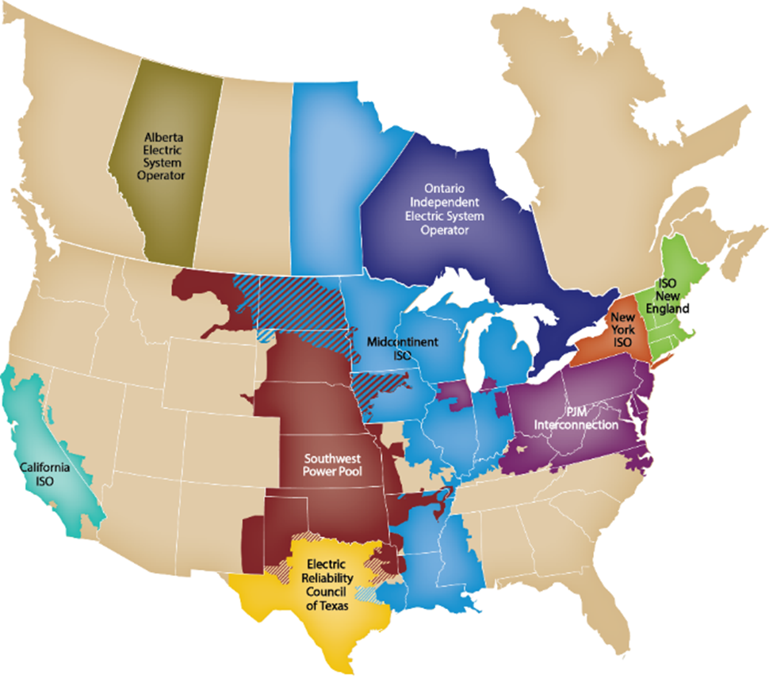

Slide 4
State governments are returning to the game to “fix” incompatibilities between national policies and state decarbonization commitments
A growing number of states have made aggressive decarbonization commitments and associated decarbonization trajectories
  There has been no comprehensive credible national GHG policy to meet GHG mitigation and reliability criteria
    The Biden administration has articulated national decarbonizations goals but only indirect mostly tax incentive mechanisms and technology mandates (e.g. EVs) to achieve them
  There is a large gap between Democrats and Republicans and future policies are uncertain
  Future wholesale market price distributions will change dramatically but how and when are very uncertain
  The “invisible hand” will not lead to efficient investment that meets decarbonization and reliability (RA) criteria based on short-term wholesale market price signals
  Long-term PPAs selected through competitive procurement can meet investment goals at the lowest cost
Mandate competitive procurements supported by long-term PPAs with high credit counterparties to fill part of the gap between trends and commitments
  Wind, solar, storage, nuclear, etc.
  10 to 20 years
  Repeated sequential auctions (single technology vs. technology neutral)
  Procurement without a plan is bad so long-term capacity planning and dispatch models are being used to develop “pathways to net zero” (eventually)
  These indicative plans are the foundation for competitive auctions and can be adjusted in subsequent auctions based on earlier auction results (price caps in MA)
  Merchant pathways, including “corporate” PPAs, are permitted with various carbon mitigation “crediting” arrangements
And we are moving, perhaps by default, to hybrid markets

Slide 5
Some Examples
Via state mandated procurement of hydro, wind, solar, and storage pursuant to LT contracts in “restructured” market areas
  Maine
  Massachusetts
  Connecticut
  New York (and NYC)
  New Jersey
  Maryland
  DC
  Illinois
  California (RA)
Via LSE contracting requirements in restructured states without retail competition
  California
Via IRPs and COS regulation in states that have not fully restructured
  Virginia
  Oregon
  Nevada
Via PURPA
  Arizona
  California

Slide 6
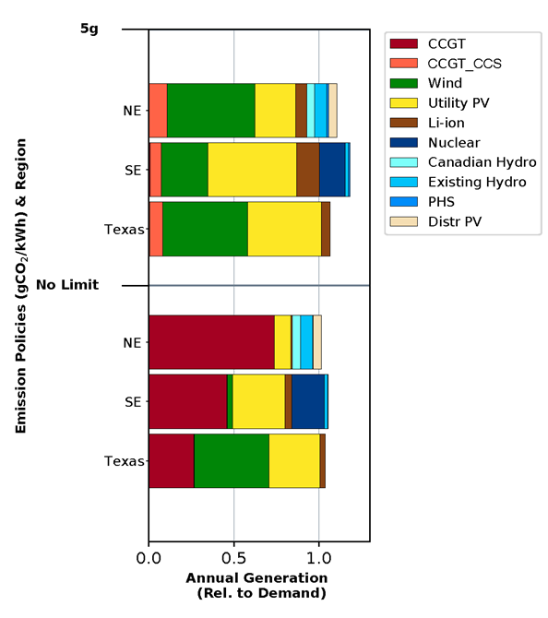
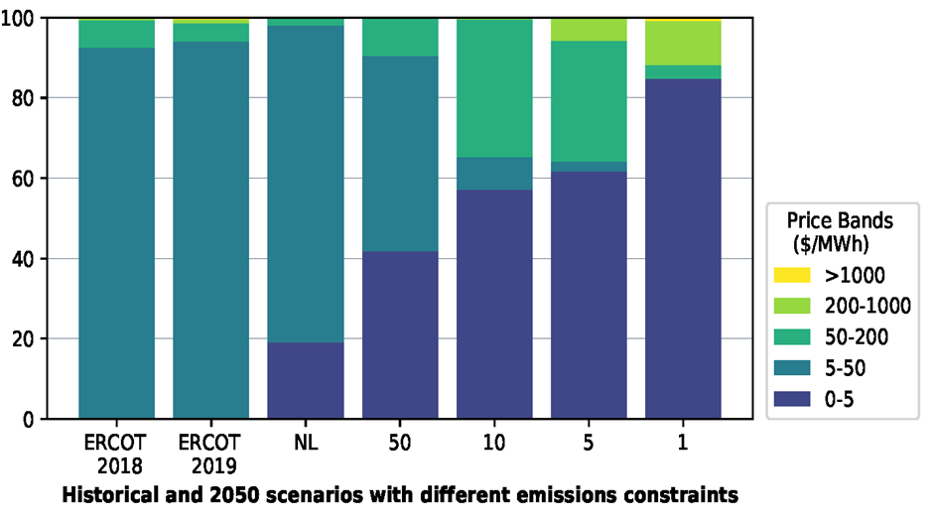
2050 Scenarios
MIT Future of Storage Study (2022)
Annual generation mix
Frequency Distribution of Prices
Percentage of hours by Price Band

Slide 7
The Use of Voluntary “Corporate” PPAs to Meet Individual Organization’s GHG Mitigation Targets is Growing Fast
Examples
  Google (multiple contracts 7-20 years)
  Apple (multiple contracts 8-10 years)
  Microsoft (multiple contracts 10-24 years)
  Walmart (multiple contracts 7-15 years)
  Kaiser Permanente ( multiple contracts 20 years)
  Stanford University (2 contracts 24-25 years)
  State of California (many contracts typically 20 years)
  MIT --- with BMC and POSDC (one contract, 25 years)
Types of purchase arrangements
  Physical
  Financial (virtual with RECs)
  Special Utility Tariffs

Slide 8
As cited in CEGP (Columbia) 2021

Slide 9
Primary Take-aways for Today from Corporate Procurement Behavior
Long Term PPAs are viewed by these organizations as the most economical way of purchasing wind and solar to meet organizational GHG mitigation goals/obligations
  Overall lower cost of capital and less costly way for buyers to achieve GHG goals
  Buyers are attractive counterparties with excellent credit ratings and developers can finance the project with low cost of capital (WACC)
  Buyers get a long-term contract for CO2-free energy (or REC credits) to meet their internal GHG goals at lower costs than buying equivalent energy or RECs in short-term markets
  Sellers can mitigate most market risks with de facto fixed price contracts and must focus on cost containment and meeting contract performance criteria
  Risk allocation depends on contract design and interaction with energy and AS markets (e.g. basis risk due to aggregation of LMPs to contract settlement points )
  In U.S. today largely based on minimizing the cost of meeting internal organizational GHG goals without regard to matching internal supply and demand or considering system effects, especially reliability considerations

Slide 10
The Walmart View
Walmart: https://cdn.corporate.walmart.com/eb/80/4c32210b44ccbae634ddedd18a27/walmarts-approach-to-renewable-energy.pdf

Slide 11
The Google View
Google has signed 19 more agreements with a variety of structures (including PPAs) totaling nearly 2.6 gigawatts of renewable energy in the U.S., Europe, and South America, and the U.S. corporate PPA market has grown 60% year over year. We’re particularly pleased that in some markets, like Northern Europe and Chile, we’re able to buy from a developer through a PPA and then supply that renewable energy directly to our local data centers. “Many new projects have been built around the world,” Demasi says, “because of the commitment that Google made.”
We’ve had great success securing significant amounts of renewable energy at rates that are competitive with nonrenewable sources, proving that you can do great things for the planet and support the bottom line. But in many ways PPAs remain an imperfect model. And although there are more options today than there were in 2009, few utilities offer renewable energy to their customers. “A huge evolution needs to occur in the utility sector,” Demasi says, “for us to be able to buy the power we want from the source we want with the contractual flexibility and agility we need.” The industry is making good progress. But we’re still a long way from an ideal system for bringing renewable power from where the wind blows and the sun shines to where people live and work.
https://sustainability.google/progress/projects/ppa/

Slide 12
Grubb and Newbery EJ-2018

Slide 13
Many Issues to be Addressed
Discuss three here
  Competitive procurement (“auction”) design and evaluation
  Wind and solar PPA/contract design
  Storage PPA design
Integrating RA/SoS consideration into the competitive procurement and evaluation process
  Changing stochastic properties of supply and demand in high VRE systems
  ELCC, etc.
  Not today

Slide 14
Auction Design and Evaluation Issues for State Mandated Procurement
Who designs, runs the auctions and evaluates the offers?
  State entities (e.g. NYSERDA in New York, Illinois Power Agency)
  State PUCs with help of independent consultants and (perhaps) ISO (e.g. New Jersey BPU and PJM for OS wind)
  Individual or groups of LSEs with independent consultants and PUC approval (e.g. California, Massachusetts)
Who is the counterparty to the PPA?
  Ultimately it is typically the distribution companies and the prices paid by their delivery customers in the state --- even in retail competition states
  Complicated --- need to follow the money (PPAs, RECs allocated to distribution companies)
Technology specific or all source meeting decarbonization criteria?
  Dynamic use of optimal system models to define mix of technologies
What region is covered by the procurement?
  State (does this make any sense? --- e.g Northeast off-shore wind)
  Region
Offer evaluation is complicated and there is limited transparency
  Many factors in bid evaluation with price, financing, permits, RA value, time to complete, and developer experience the most important

Slide 15
Wind/Solar PPA Pricing Issues
PPA Pricing today
  Fixed price/MWh with MWh generation and performance commitments
  Fixed price/MWh with escalation over time with MWh generation and performance commitments
  CfD with strike price determined through competitive bidding process with MWh and performance commitments
With/without “shaped” prices around generation commitments, time series variability in wind/solar resources, LMP basis risk, and management of curtailments/congestion
Prices, cost structure, incentives: Fixed capital and O&M costs with SRMC of operation close to zero
Since SRMC of generation is close to zero for wind and solar, a PPA price > zero provides good production/availability performance incentives absent curtailment conditions
  The more you produce the more you get paid
P > SRMC may distort management of curtailments and associated (negative) market prices with potential follow-on investment distortions in the market
  Move to fixed payments based on capacity, capacity factor modelling, and availability
  Same story as with retail pricing
Recovering fixed costs associated with wind, solar and storage projects through per MWh charges in LT PPAs likely reinforces the imperfections in retail rates which also recover the bulk of what should be fixed charges in per/KWh charges

Slide 16
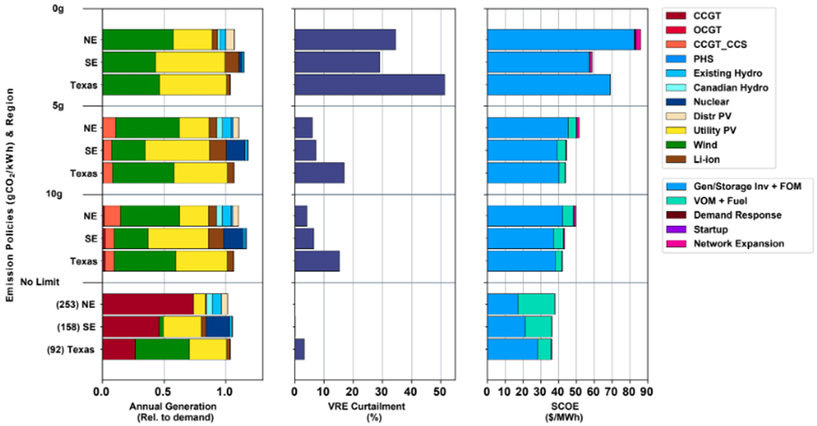
MIT Future of Storage Study (2022)
Figure 6.4: Annual generation, VRE curtailment, and system average cost of electricity (SCOE) in the Northeast (NE), Southeast (SE), and Texas (TX) under tightening CO₂ emissions constraints. SCOE includes total annualized investment, fixed O&M, and operational costs of generation, storage, and transmission, as well as any non-served energy penalty. Emissions intensity under the No Limit policy case is noted in parentheses in the bottom panel. For the Northeast region, “Wind” represents the sum of onshore and offshore wind generation.

Slide 17
Source: CAISO 2022

Slide 18
Source: CAISO 2022

Slide 19
CAISO, Market Monitoring Report, July 2022

Slide 20
LAP = load aggregation point
(settlement point)
CAISO, Market Monitoring Report, July 2022

Slide 21
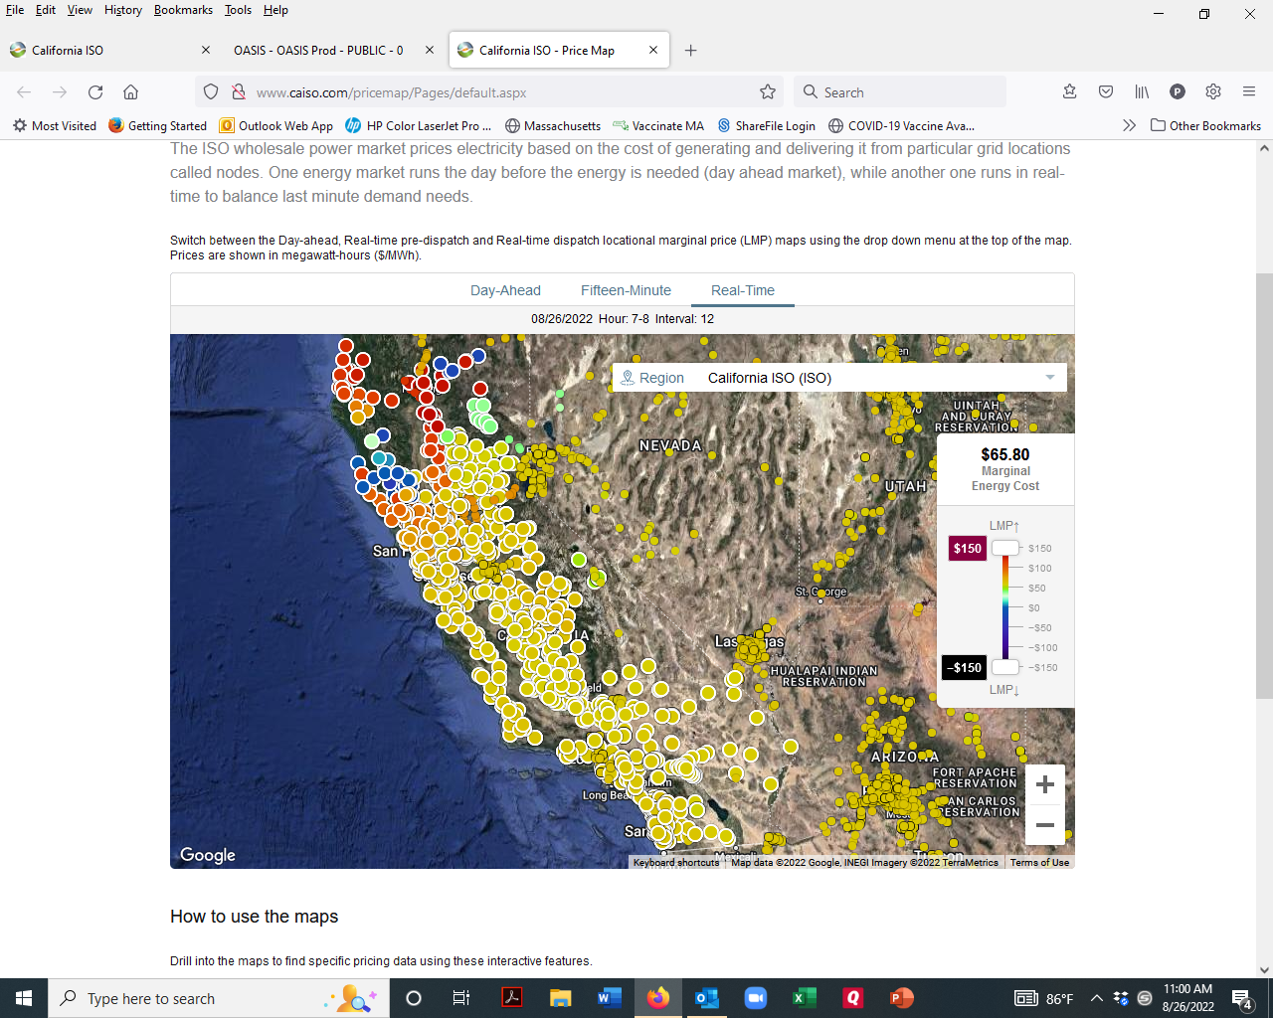
August 26, 2022
8:15 AM PDT

Slide 23
Southwest Power Pool, State of the Market Report, 2022

Slide 24
Storage PPA Pricing Issues
Storage has several potential revenue streams
  Arbitrage profits
  Ancillary/grid services
  RA services
  Transmission/interconnection deferrals
We want storage to charge/discharge in response to short-term (spot) wholesale price variations for these services
Integration of storage into wholesale markets is still evolving
Value of storage depends on capacity( MW), duration (MWh/MW), charge/discharge attributes and that’s what PPA prices should reflect not per MWh “supplied”b
Competitive auction structure should allow bidders to account for expected value of future revenue streams and differences in storage attributes

Slide 25
LBNL 2022

Slide 26
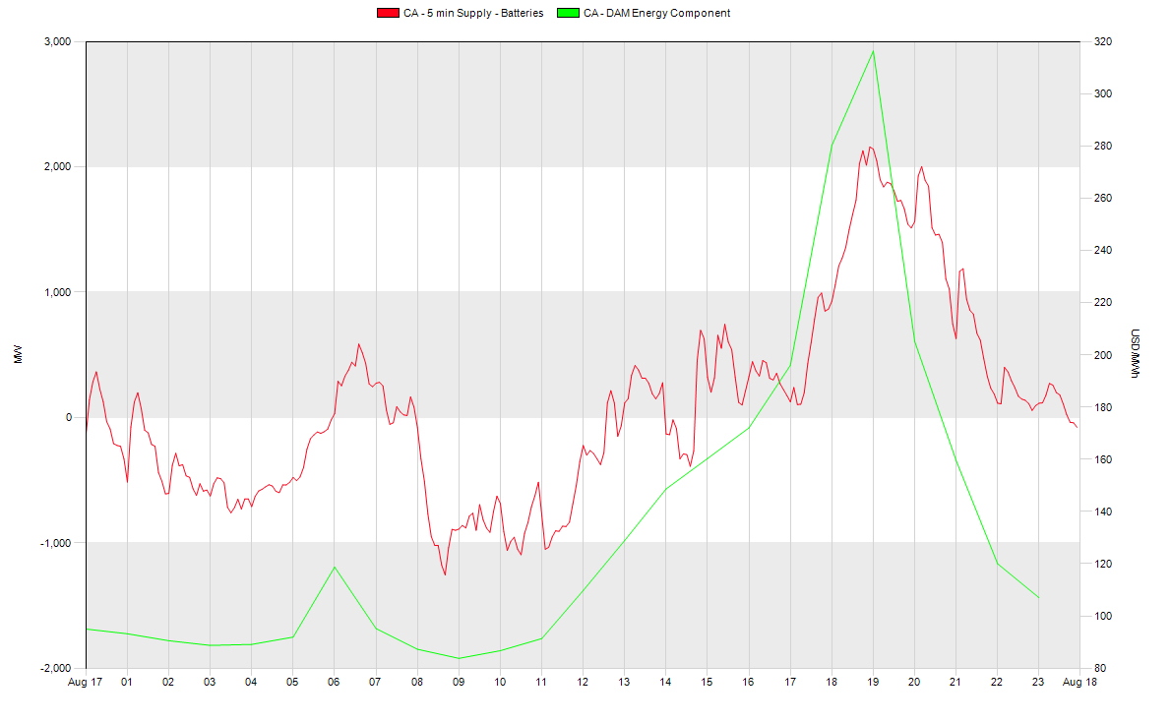
CAISO Battery Supply and Market Prices (August 17, 2022)
Note: Prices are for energy component
and do not include congestion cost
which varies by node
discharge
Prices
$/MWh
charge
Source: NRGStream Trader 8.1

