Slide 1

Locational pricing: The REMA debate so far and a way forward
EPRG 2024
Jason Mann
17 May 2024

Slide 2
Good to be back at EPRG. Will discuss the perennial issue of market design and REMA. I have three key messages to put forward today….
Those opposed to the introduction of locational pricing as part of REMA are probably going to be disappointed….
…proposed alternative measures unlikely to be effective in addressing identified issues
1
And if locational pricing is not introduced, those against it may begin to wish it had been….
…operating under a national pricing system into long term likely to be riven with policy uncertainty and stakeholder acrimony
2
Nature of locational pricing debate to date has been hugely polarising….
…we need to find a way forward. Some thoughts on this.
3

Slide 3
1. Why locational wholesale pricing is likely to be implemented…

Slide 4
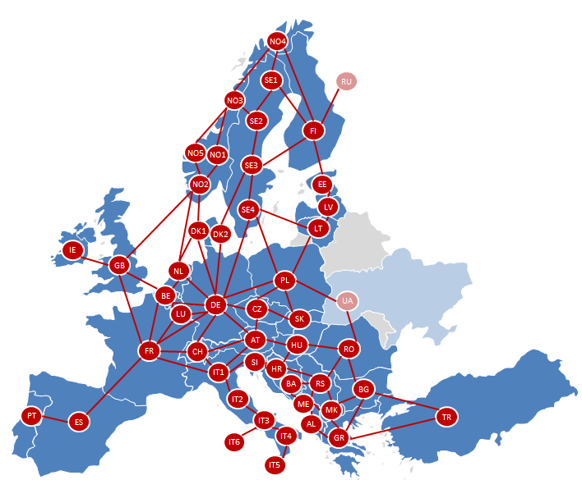
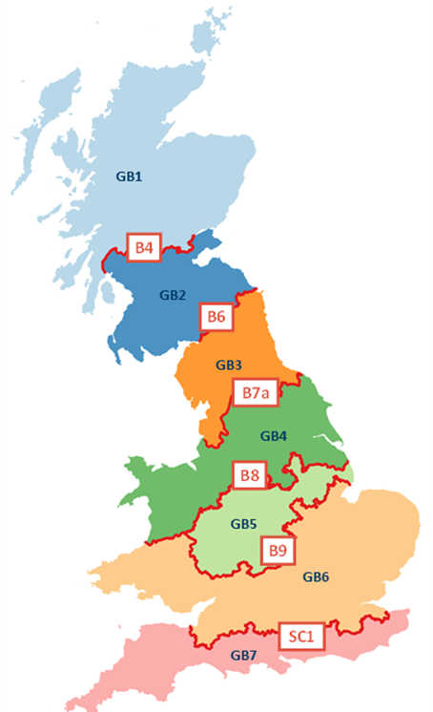










As most are aware, Ofgem commissioned FTI to undertake a cost benefit assessment of a more locational GB power market
As part of this, we developed a locational market model of the GB power market allowing us to compare market outcomes between market designs…
National
Zonal
Nodal
Single price
Uniform price clears across entire market
System divided into seven zones with individual prices
System divided into c.850 “nodes” with individual prices
GB
Germany
Australia
Sweden
USA
New Zealand
Norway
Italy
Canada (Ontario)
Singapore
… and we also assessed wider system impact of implementation costs, financing costs and liquidity

Slide 5
Wholesale electricity prices vary under each market design – we show example hours below
c50% of the time prices would be roughly the same between a national and locational market (i.e. +/-20%)….
A very high wind hour across GB (29th Sept 2040 – 12pm)
A low wind hour in the north (27th Feb 2025 – 8am)
…but the other 50% of the time there is a material different locational price relative to national price in some regions
A high wind hour in the north (17th Jan 2040 – 5pm)
A very high wind hour in the north (10th Dec 2040 – 5pm)
Note: Precise figures for 2035 under LtW (NOA7) scenario: 48% of hours in 2035 there is a difference between national and all locational prices of less that +/- 20%. For 52% of hours the difference between two market designs is greater than +/-20%
Source: FTI Consulting

Slide 6
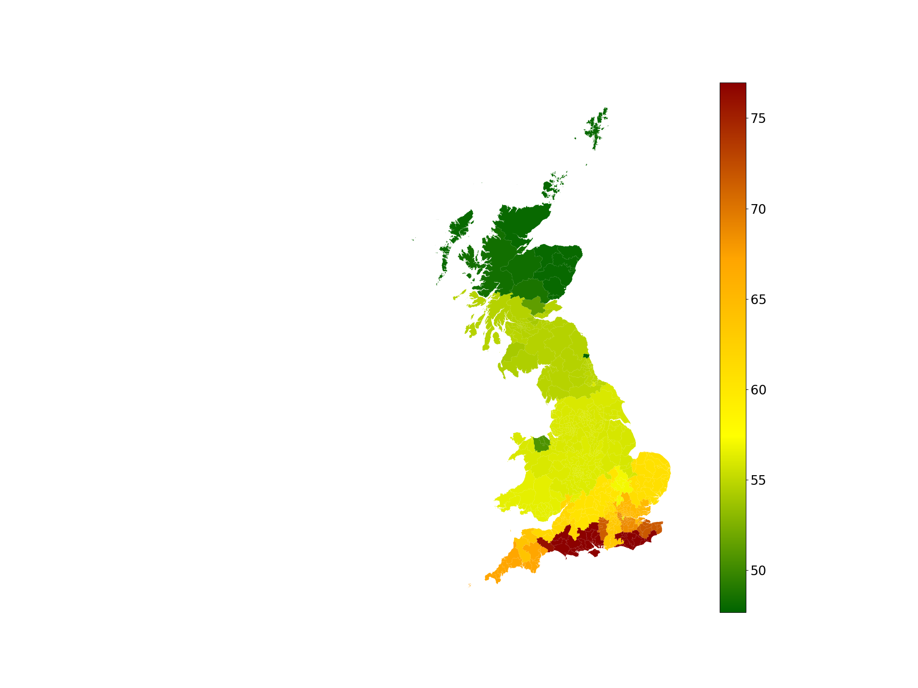
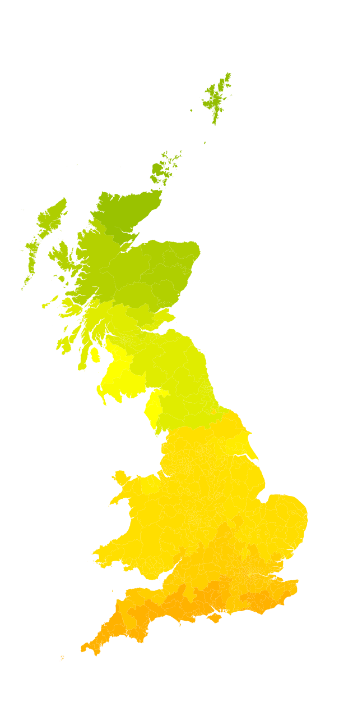
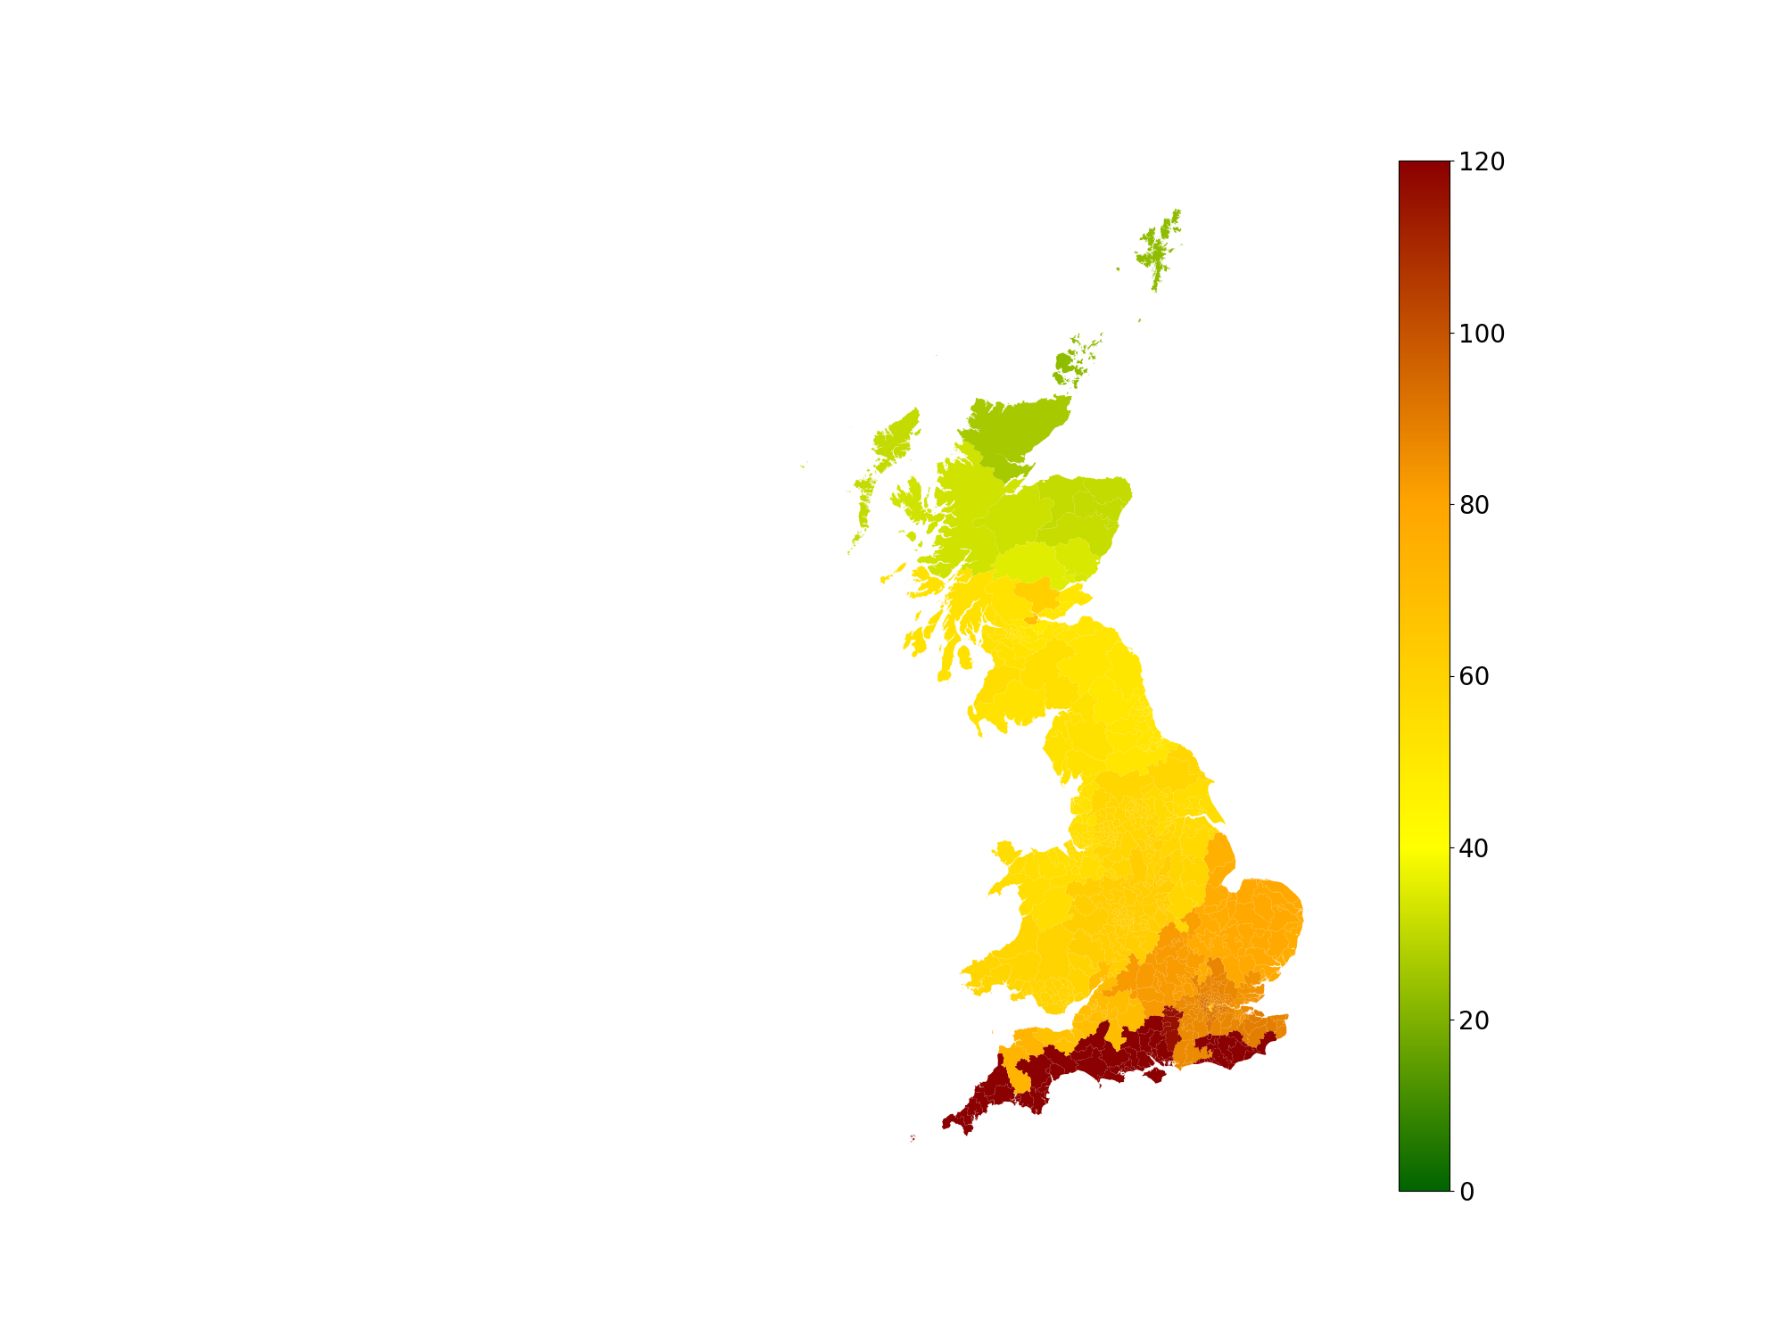
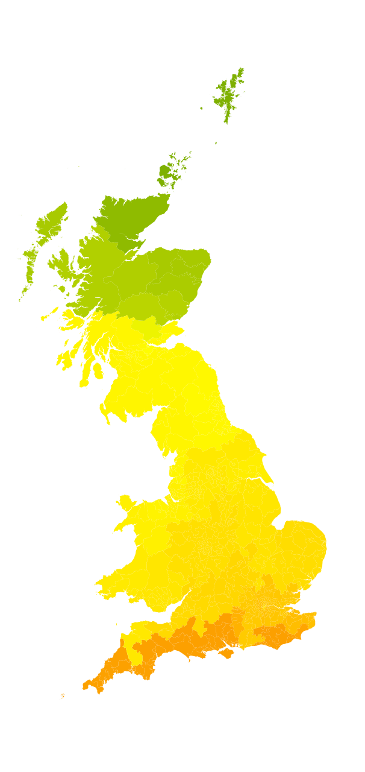
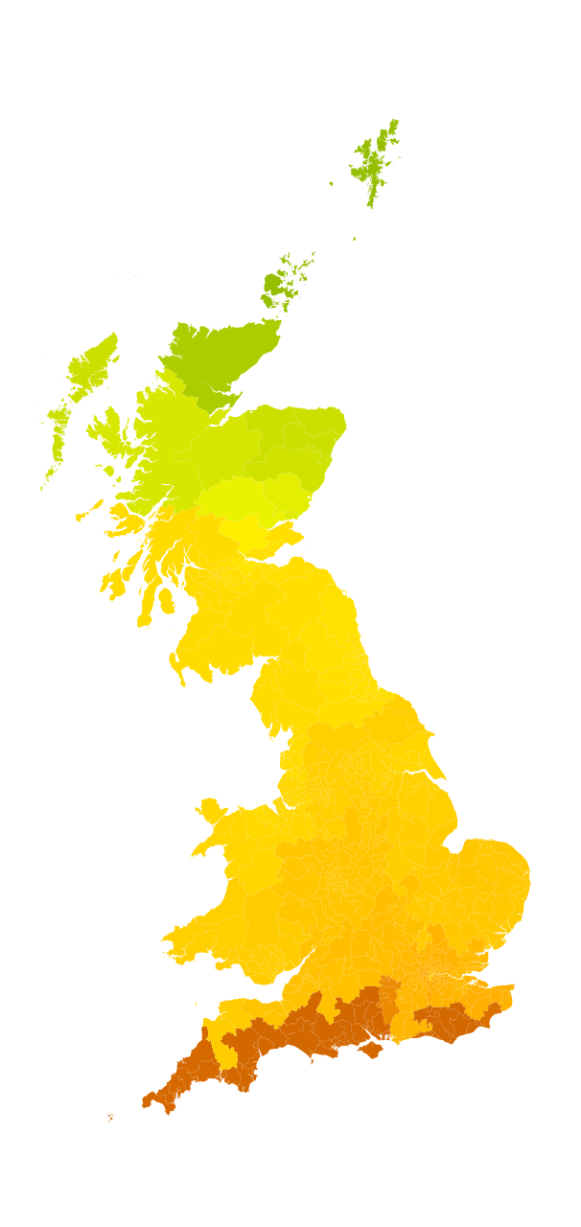
Our updated modelling shows that despite huge increase in transmission, would still be significant variations under a locational pricing regime with FES
We forecast the locational price in each node, updating the model for latest assumptions…
…and improved our graphical interface
We now have a 1,200+ node model…
… and an updated transmission programme¹
Annual average prices by node 2030 – 2050
£/MWh
£/MWh
2030
2035
2040
2045
2050
Source: FTI Consulting
Note: We estimate over c.£110bn of transmission spend by 2037 updating from the Beyond 2030 report
Note: Different scales
Note: Nodal price calculated, but a zonal price would produce a similar level of variation
We have kept the transmission network the same from 2040-50 due to a lack of publicly-available information

Slide 7
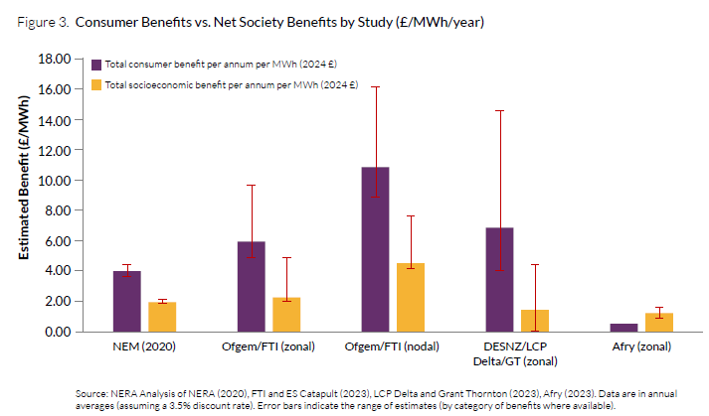
Since last year, the benefits case of locational pricing has been modelled extensively. DESNZ modelling zonal results in line with ours
Breakdown of consumer surplus and welfare (£bn, Present Value 2025-40, Nodal – National, Leading the Way NOA7)
DESNZ: Zonal pricing still in play
“Zonal Pricing has the potential to lead to savings for the typical household in all regions”
DESNZ: Nodal pricing discounted – albeit with no supporting quantitative evidence (other than FTI model)
“Theoretical benefits of nodal pricing may be overstated through some modelling exercises”
Source: FTI analysis (above), NERA benchmarking analysis (below)

Slide 8

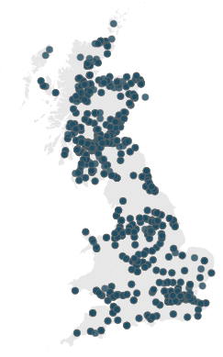

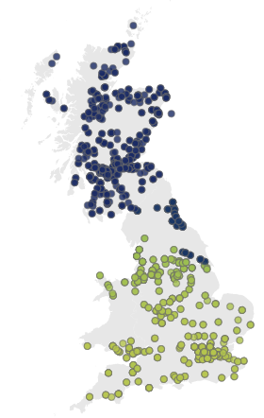







The deal breaker for the status quo is the use of flexible assets under a national market. DESNZ have also found flexible asset scheduling a major issue
Example of the impact of nodal pricing on interconnectors
Snapshot – 09/03/2030 @8am
National
Nodal
Wholesale prices
Wholesale prices
£7.7
Wholesale prices
£5.2
£13.9
1.4GW
£0.0
1.4GW
£7.7
£5.2
1.4GW
0.9GW
£ 13.9
£ 4.9
£0.0
0.1GW
£0.0
0.8GW
1.4GW
1.4GW
£14.3
£83.5
£79.4
£83.5
1.4GW
No flow
£83.5
0.4GW
£83.5
2.4GW
1.4GW
£83.5
£83.5
2.5GW
2.2GW
£ 13.9
7.7GW
£ 81.4
6.1GW
Price £/MWh
£14.3
0
155
£79.1
Source: FTI Consulting
Note: We follow ENTSO-E’s methodology model which includes consideration of the transmission network between NI and ROI

Slide 9
Over a year the distortions in interconnector scheduled flows are very material
Change in interconnector flows (nodal relative to national)
Under a national market design, GB is scheduled to “over export” and “under import” to France by 10 – 15 TWh per year
And scheduled to “over import” and “under exports to Norway by 2 – 4TWh per year
Net change to exports (TWh)
-7
-13
-9
-10
-5
-3
-5
-6
+0
+1
+1
+1
+1
+3
+3
+6
Net change to imports (TWh)
+3
+2
-1
-2
+0
+2
-0
-1
+0
-0
+0
-0
-1
-1
+0
+1
Source: FTI Consulting

Slide 10
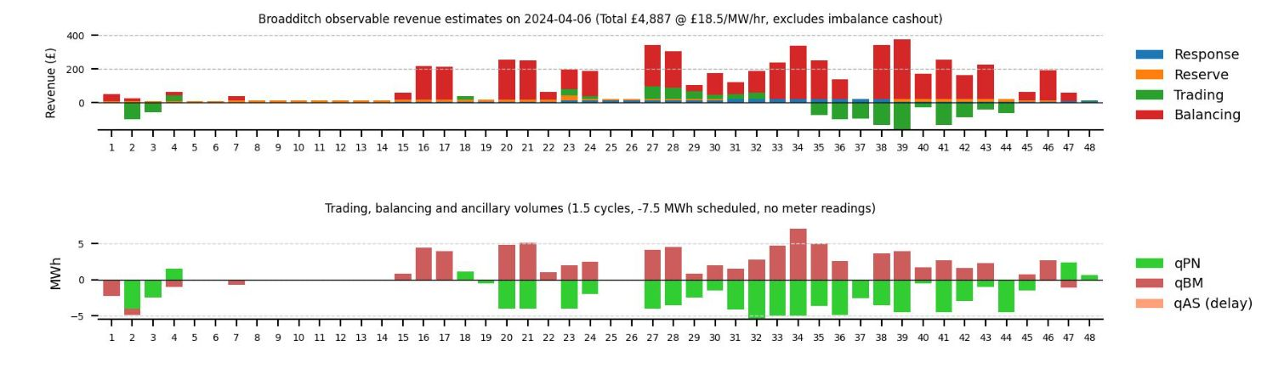
Batteries and, eventually other flexibility assets such as V2G and demand side in general, will frequently face perverse signals in a national wholesale market
In northern windy hours with active constraints such as this one, storage in the north has signal to discharge which worsens congestion (same applies to pumped storage)
Example of a moderately high wind hour in the north
The converse is true in other hours of plentiful wind for southern sited storage…
…as happened on 6th April this year
Example of a very high wind hour in the north
Source: John Perkins LinkedIn post in April 2024, chart derived from bessanalytics
We find that in 2035, the % of hours where batteries (in aggregate) were scheduled to run in the “wrong direction” was over 20%
Source: FTI Consulting

Slide 11
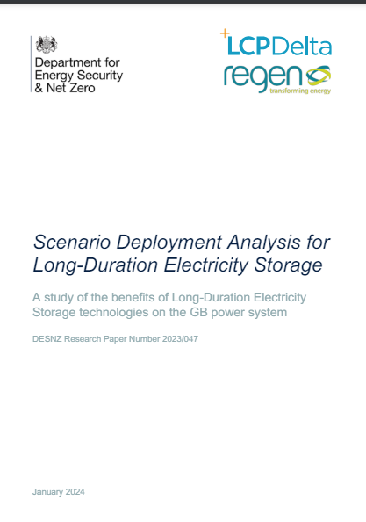
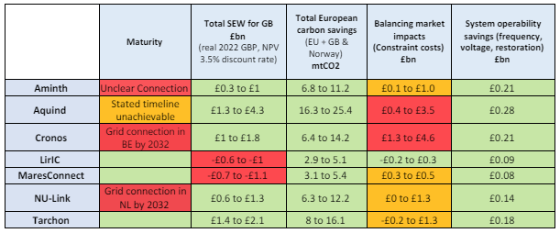
Under current market design flexible assets will struggle to get regulatory approval in Scotland and southern England
LCP / Regen found that 10GW LDES in Scotland could increase constraint costs by £0.7bn as may be “often discharge at times of locational constraints over the B2 and/or B6 boundaries”
A consequence of national pricing is flexible assets might only be able to be built in the middle of country (and perhaps not even in East of GB too)
Ofgem modelling shows proposed interconnectors south of London failing regulatory test due congestion costs
Source: FTI Consulting, LtW (HND) scenario, 2035

Slide 12

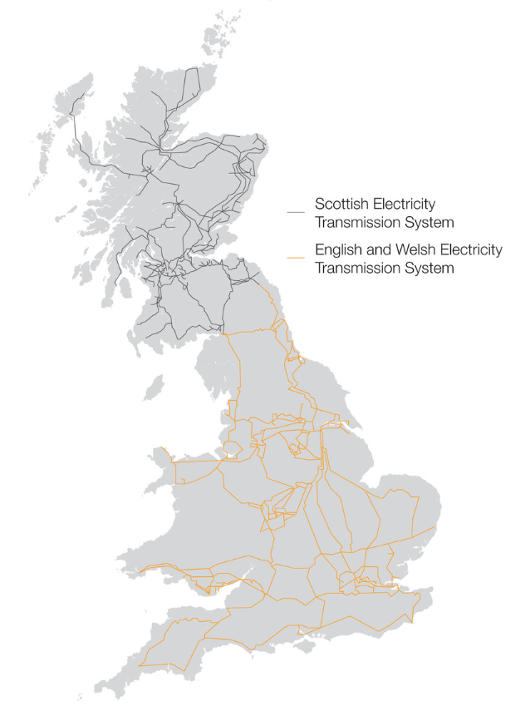





To fix the flexible asset issue a plethora of “overlays” to current market design suggested by proponents of status quo. Bad news is none of them will work….
1
2
Continue firm access rights for ICs and/or other flex assets…
Change to non-firm rights for ICs and/or other assets
(e.g. new assets, or some other types)
A
B
C
A
B
Earlier gate closure
Split and extended market for constraints
Incentivise more accurate Physical Notifications
Restrict entry & exit capacity onto GB grid dynamically
Dynamic entry and exit TNUoS for ICs (or others)
X
Entry TNUoS charge at X: H1: £X/kW
H2: £X+10/kW
Current
WM
BM
IC redispatch
IPN
FPN
Option 1B
WM
BM
Entry limit: H1: 1000MW
H2: 1,200MW
Option 1A
WM
BM
Current
WM
BM
Exit limit:
Hour (H)1: 600MW
H2: 200MW
E.g.: T-8
T-1
RT
E.g.: T-8
T-1
RT
D-1
T-1
RT
I
II
I
II
I
II
Y
Entry TNUoS at Y:
H1: £Y/kW
H2: £Y - 6/kW
IC redispatch
Separate constraints market (e.g. CMIS)
FPN incentive (information imbalance charge)
IPN incentive
Uncompensated curtailment (e.g Germany I/Cs / Australia)
Auctions entry / exit capacity (e.g. NBP entry)
More time for SO to optimise system
Risk of negative impact on market efficiency (esp. intra-day trading)
Increased need for Balancing Services
Contradictory to key principle and spirit of GB market design
Historical precedent (pre c2010) of ICs paying TNUoS
Set ex ante (or ex post) TNUoS charge half hourly to impact i/c user flows
Hugely challenging to implement – requires forecasts of prices and opportunity costs…
Somewhat arbitrary – will often get forecast wrong and lead to inefficient IC use and, in turn, other GB flex assets
Could improve SO to SO trading for ICs
Other assets classes could operate similarly
Simultaneous and contradictory price signals potentially to lead to perverse outcomes…
… and inc/dec gaming risk huge
Incentivises more accurate PNs…
…but efficiency of benefits unclear
Greater risk to participants
Somewhat arbitrary setting of level of charge
Lower costs – IC flows better match GB internal constraints
Perception of arbitrary curtailment
Only works for one way for IC
Disorderly bidding risk
Higher national prices risk
could (in theory) lead to more efficient IC usage…
…but hugely complex (perhaps impossibly so)
Operational challenges –requires SO judgement
By design cannot lower constraint volumes…
…..but may lower costs (a bit)
Somewhat arbitrary, significant potential for inefficient outcomes and/or losing merit order. Potentially adverse revenue implications for impacted asset classes

Slide 13
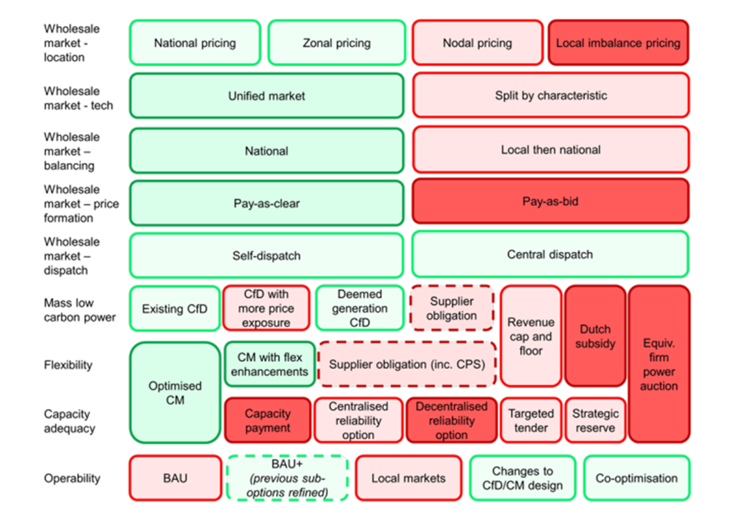
Increasingly obvious that policymakers' room to manoeuvre is a lot less than they thought – they only really have three options…
Current REMA debate is really a discussion along this spectrum
Make physical electricity system more like current market design
Make electricity market more like current GB physical electricity system
A
B
Implications:
c.£110bn+ of new transmission;
Deliverability challenges
Fierce local resistance;
Most of it unneeded in locational pricing regime
Outcome:
£0.5b implementation cost (system, changing market rules ,and contracts) to induce different participant behaviours
Cost of capital claims unproveable, no evidence from international jurisdictions to support claims - dubious at best
Fierce opposition from vested interests
C
Outcome:
Reduced cost but accelerated climate change
Reduce Net zero ambition

Slide 14
2. Without locational pricing, the market might not be so benign as proponents of status quo hope

Slide 15
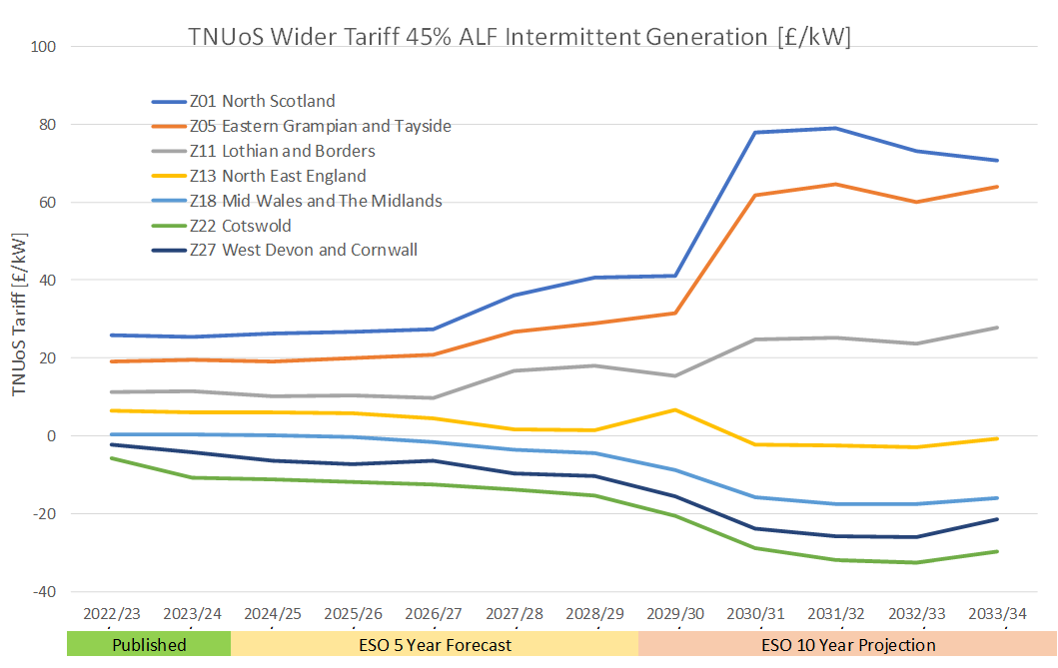
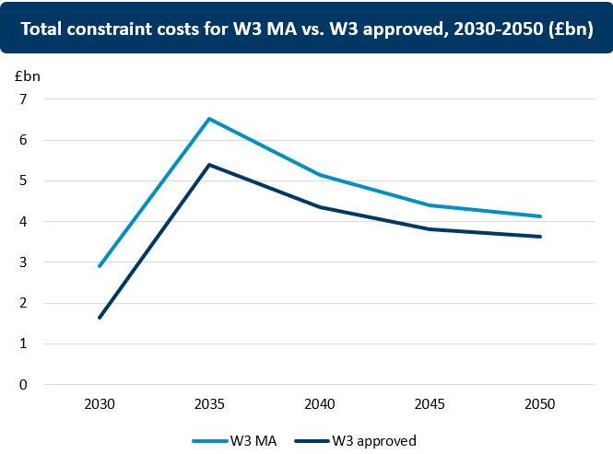
So called investor certainty under the current market design is likely to prove illusory…
ESO’s latest TNUoS 10-year forecasts, published Autumn 2023
FTI’s latest constraint cost forecast
Source: ESO TNUoS Forecast
Source: FTI Consulting
Huge hike in TNUoS bills mooted.
Administrative and subjective methodology
…given historical precedent, almost certain to end up with legal action by adversely affected parties.
Huge uncertainty therefore for investors
We forecast that despite all the transmission spend, constraint costs likely to stay high (2bn to £4bn per annum)…
…locational pricing therefore not going away as an issue.
More investor uncertainty
..any investment committee will need to consider the question of the likelihood of locational pricing being introduced in a future period

Slide 16
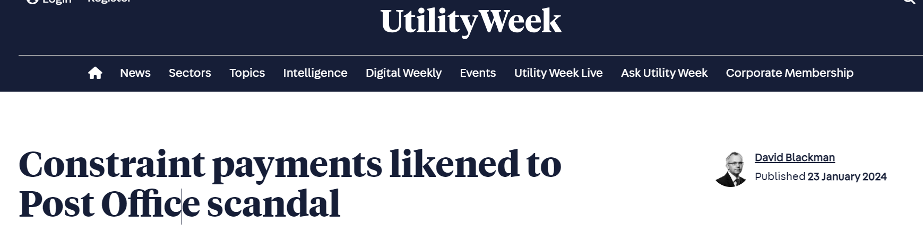
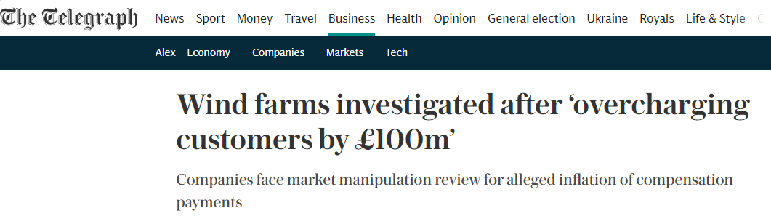
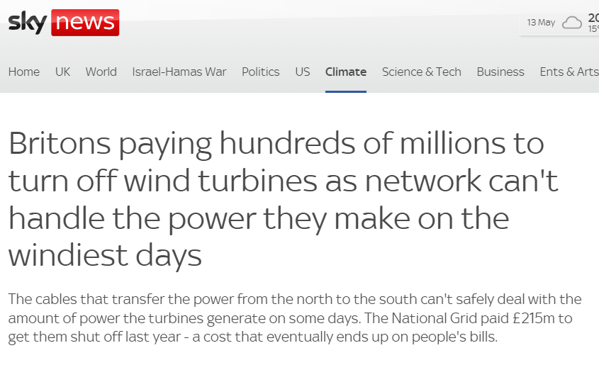
Under the status quo, payments to generators for not generating likely to increase to unprecedented high levels….
Under current market design, we estimate that Scottish generators would receive £11bn in 2025 to 2040 period for not generating…
…reasonable to ask whether this is politically and reputationally sustainable – and whether this brings risk of legal action
Source: FTI analysis (based on our LtW modelling results for Ofgem) – based on 2022 assumptions on RES costs

Slide 17
Scotland, with some of the best wind resources in Europe, could potentially enjoy the lowest wholesale electricity prices in all of Western Europe….
Under national market arrangements, GB has one of the higher wholesale electricity market prices among W.European countries
In contrast, under nodal, Scottish would have the lowest wholesale prices in W. Europe, with prices in the rest of GB also decreasing
Average national wholesale prices, 2025 (£/MWh)
Average wholesale prices under nodal, 2025 (£/MWh)
Average national wholesale prices, 2040 (£/MWh)
Average wholesale prices under nodal, 2040 (£/MWh)
…might be difficult for generators to sustain political and popular support for national pricing even within Scotland
* GB Prices include constraint cost recovered through BSUoS (indicated in red). The cost of renewable support mechanisms are not included for any country – these costs may be significant

Slide 18
3. A potential way forward

Slide 19







Not unexpectedly, the debate has been fractious – but we see a potential way forward…
Probably need to recognise that having generator capacity 10 times higher than peak demand in north is not going to work…
…but, at the same time, be respectful of historical investment decisions and develop a FTR market to help hedge locational risks
Grandfathering:
Many generators are understandably concerned about the financial hit to existing assets.
Different forms of transitional measures available but a well-designed Financial Transmission Rights market might be most efficient to facilitate this
If P2 > P1, FTR between Z1 and Z2 entitles holder to P2 – P1 for the specification of the FTR (year, MW)
Alternatively, power at hub can be traded, and Zone-to-hub FTR can be purchased
Different auction & allocation approaches available
Z₁
Source: FES 2023 LtW
Generator
P₁
P₂ ₋ P₁
N₁
Increasing demand in Scotland will be a more sustainable solution for Scottish generators in the longer run
P₂
Z₂
Locational pricing could move the dial in demand siting decisions…
…..potential for energy intensive industries to site near to generation in North as attracted by low prices
In longer run, means northern generators will have customers to sell their product to….
...rather than rely on (politically vulnerable) constrained off payments and, at the same time, hoping they can dodge paying high transmission charges
Retailer
National hub

Slide 20
It feels like it is about the right time to start talking about transitional arrangements. Some initial thoughts on design features of a regime…
Lower cost to customers…
…higher cost to customer
E.g. Cutoff start date / cutoff end date / type of asset / age of asset / losers only or winners too
1
Eligibility: What assets can be grandfathered?
Targeted
Untargeted
E.g. fixed period / asset lifetime / Trigger stop once cost recovery threshold reached
2
Duration: When do arrangements stop (and start)?
Restricted
Unrestricted
E.g. Split by capacity / deemed production / historical production / actual production
Allocation rules: On what metric are payments made
3
Complicated
Simple
Wholesale price: zonal hub price, weighted average price, simulated national price
Counterfactual: what would price and transmission been in absence of reform?
4
Reforms to status quo
Status quo
Transmission charges: Current level and methodology; or proposed future level
…huge variety of options. Will inevitably be contentious given sums involved. Place to start likely to be to agree principles of a fair transition

